Slide 1



Rack Mount Wood Board
MEMSDuino
Lafe Spietz
NIST
2024

Slide 2
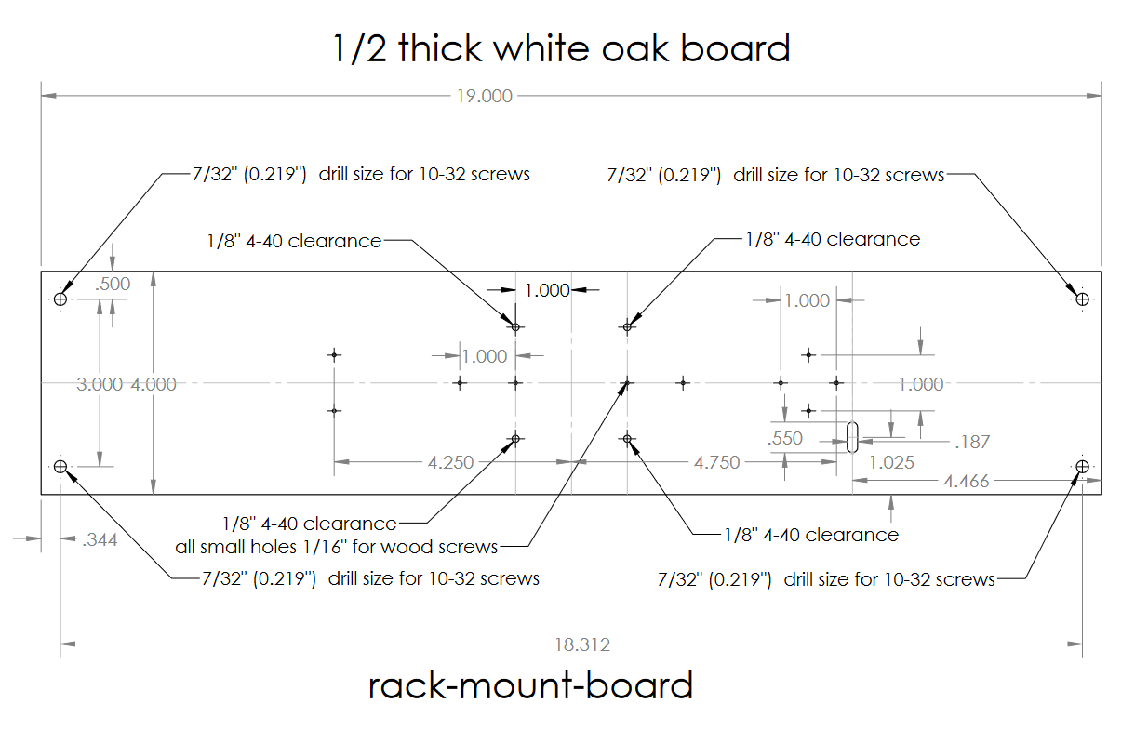

Slide 3
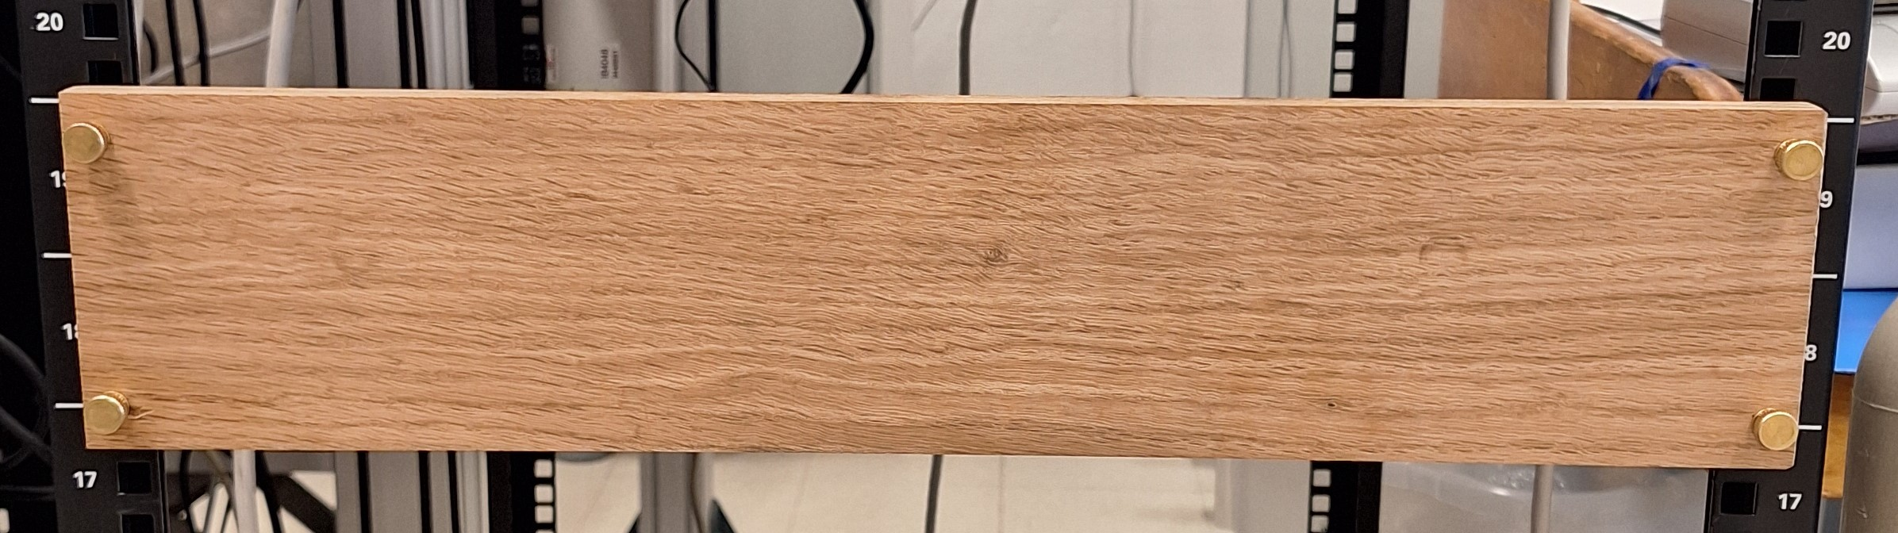
Slightly more than 2U Blank Rack Panel

Slide 4
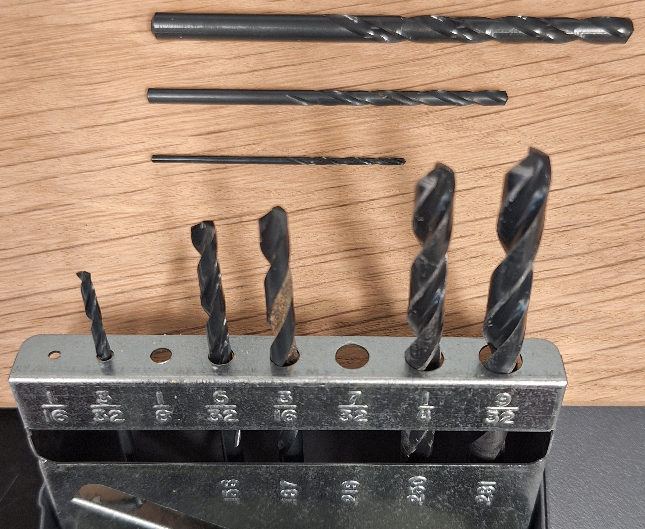
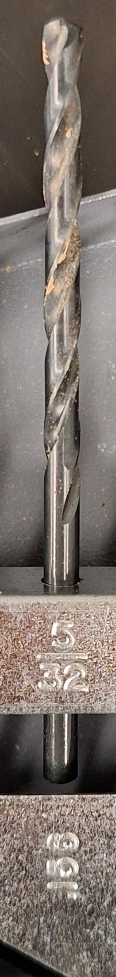
Drill bits to use
1/16” bit: pilot holes and holes for wood screws.
1/8” bit: through holes for 4-40 screws
7/32” for 10-32 thumb screw clearance holes
5/32” to mill out slot for 4 wire header cable

Slide 5
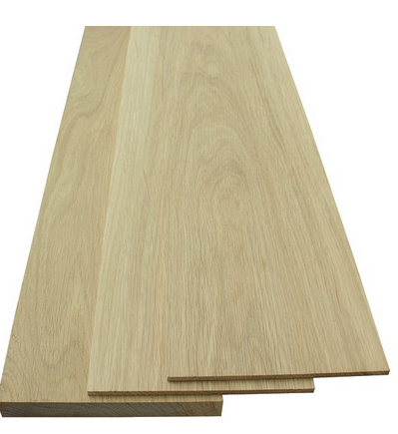
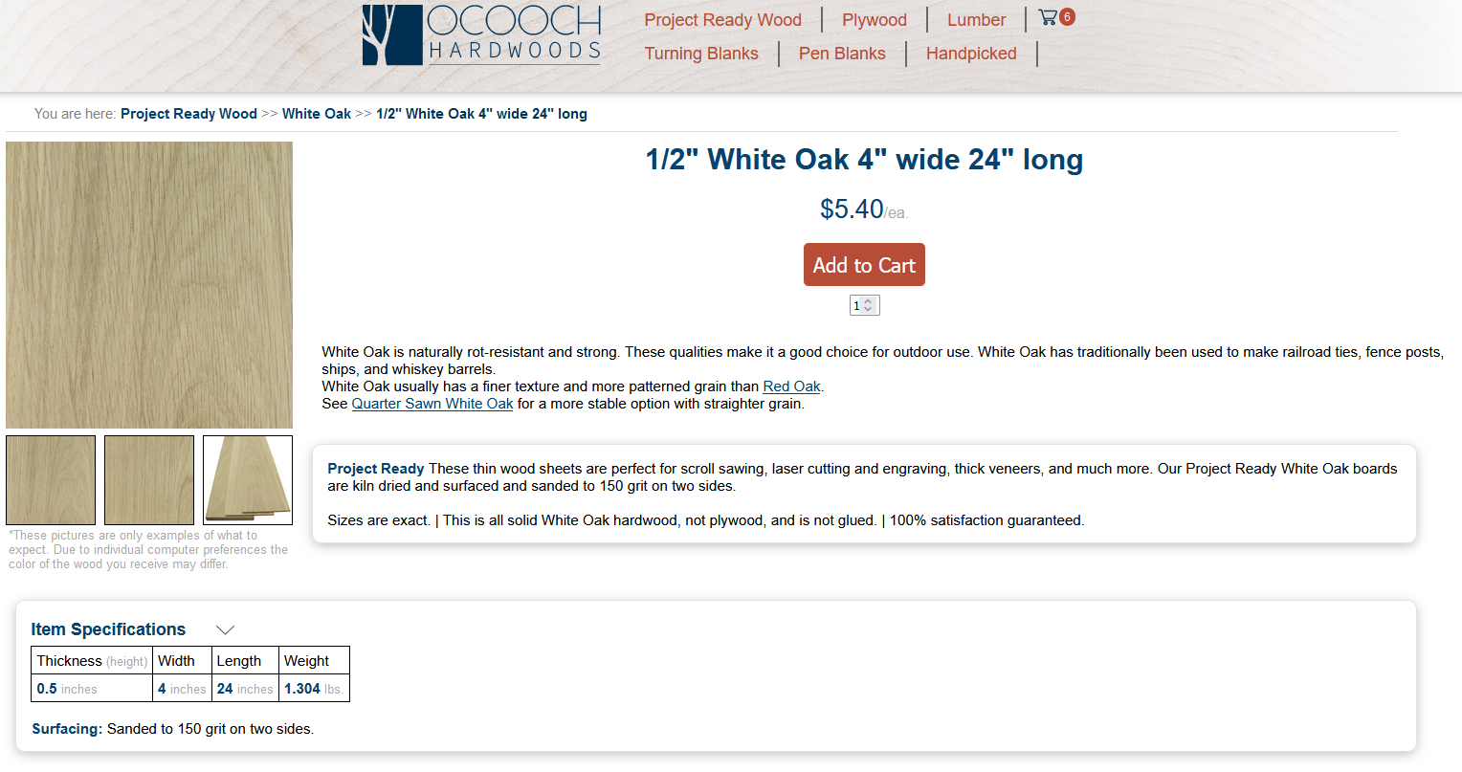
4”x24”x0.5” White Oak Boards
https://ocoochhardwoods.com/detail/?i=124wo

Slide 6
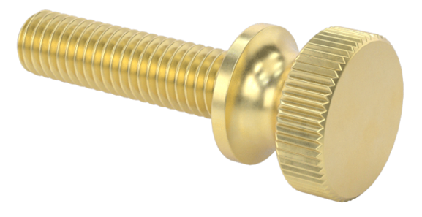
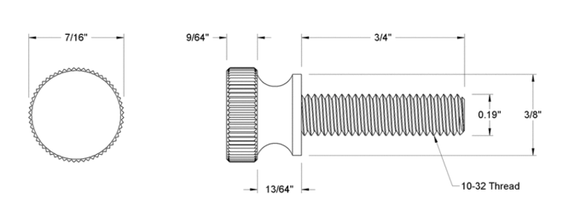
Knurled Brass Thumb Screws to Mount in Panel
https://www.mcmaster.com/92421A645/

Slide 7

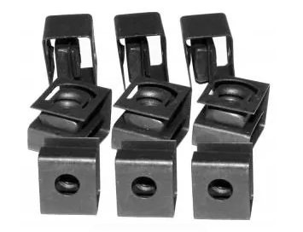
Rack Mount Nuts
https://www.mouser.com/ProductDetail/Hammond-Manufacturing/1421NP25?qs=yc9RBI4tIALvGirsWAVfbg%3D%3D

Slide 8
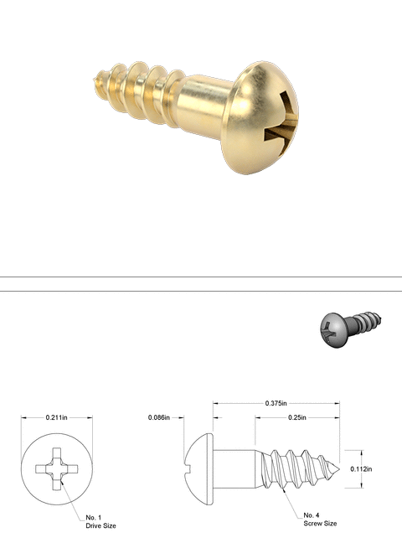
Wood screws
https://www.mcmaster.com/98685A540/

Slide 9
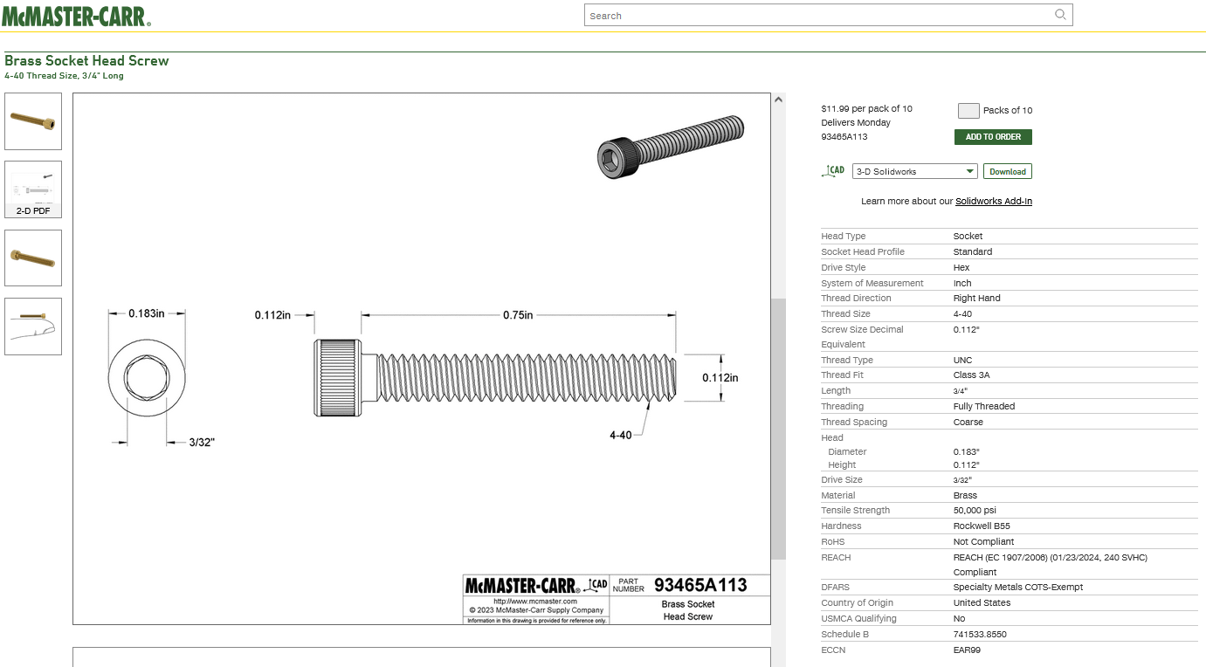
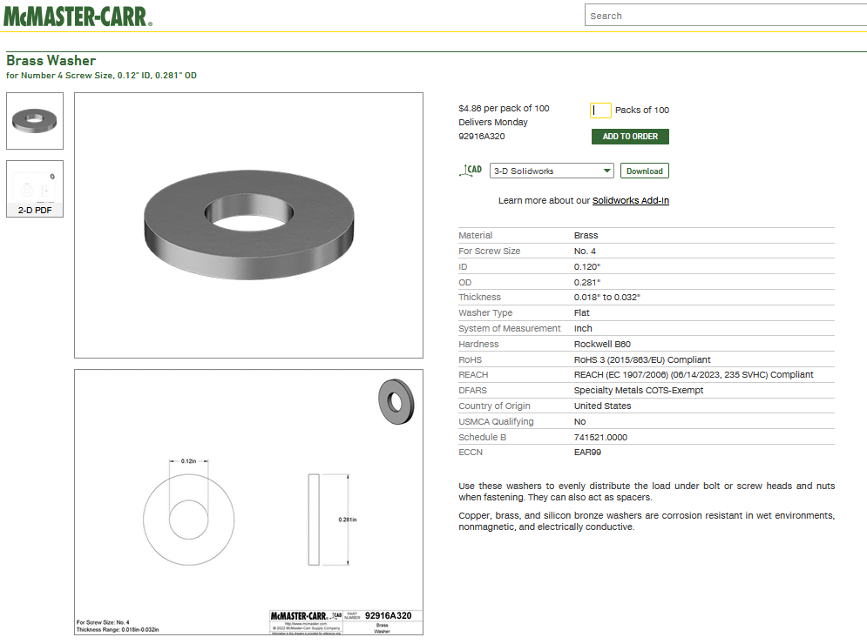
4-40 Brass screws and washers
https://www.mcmaster.com/93465A113/
https://www.mcmaster.com/92916A320/

Slide 10
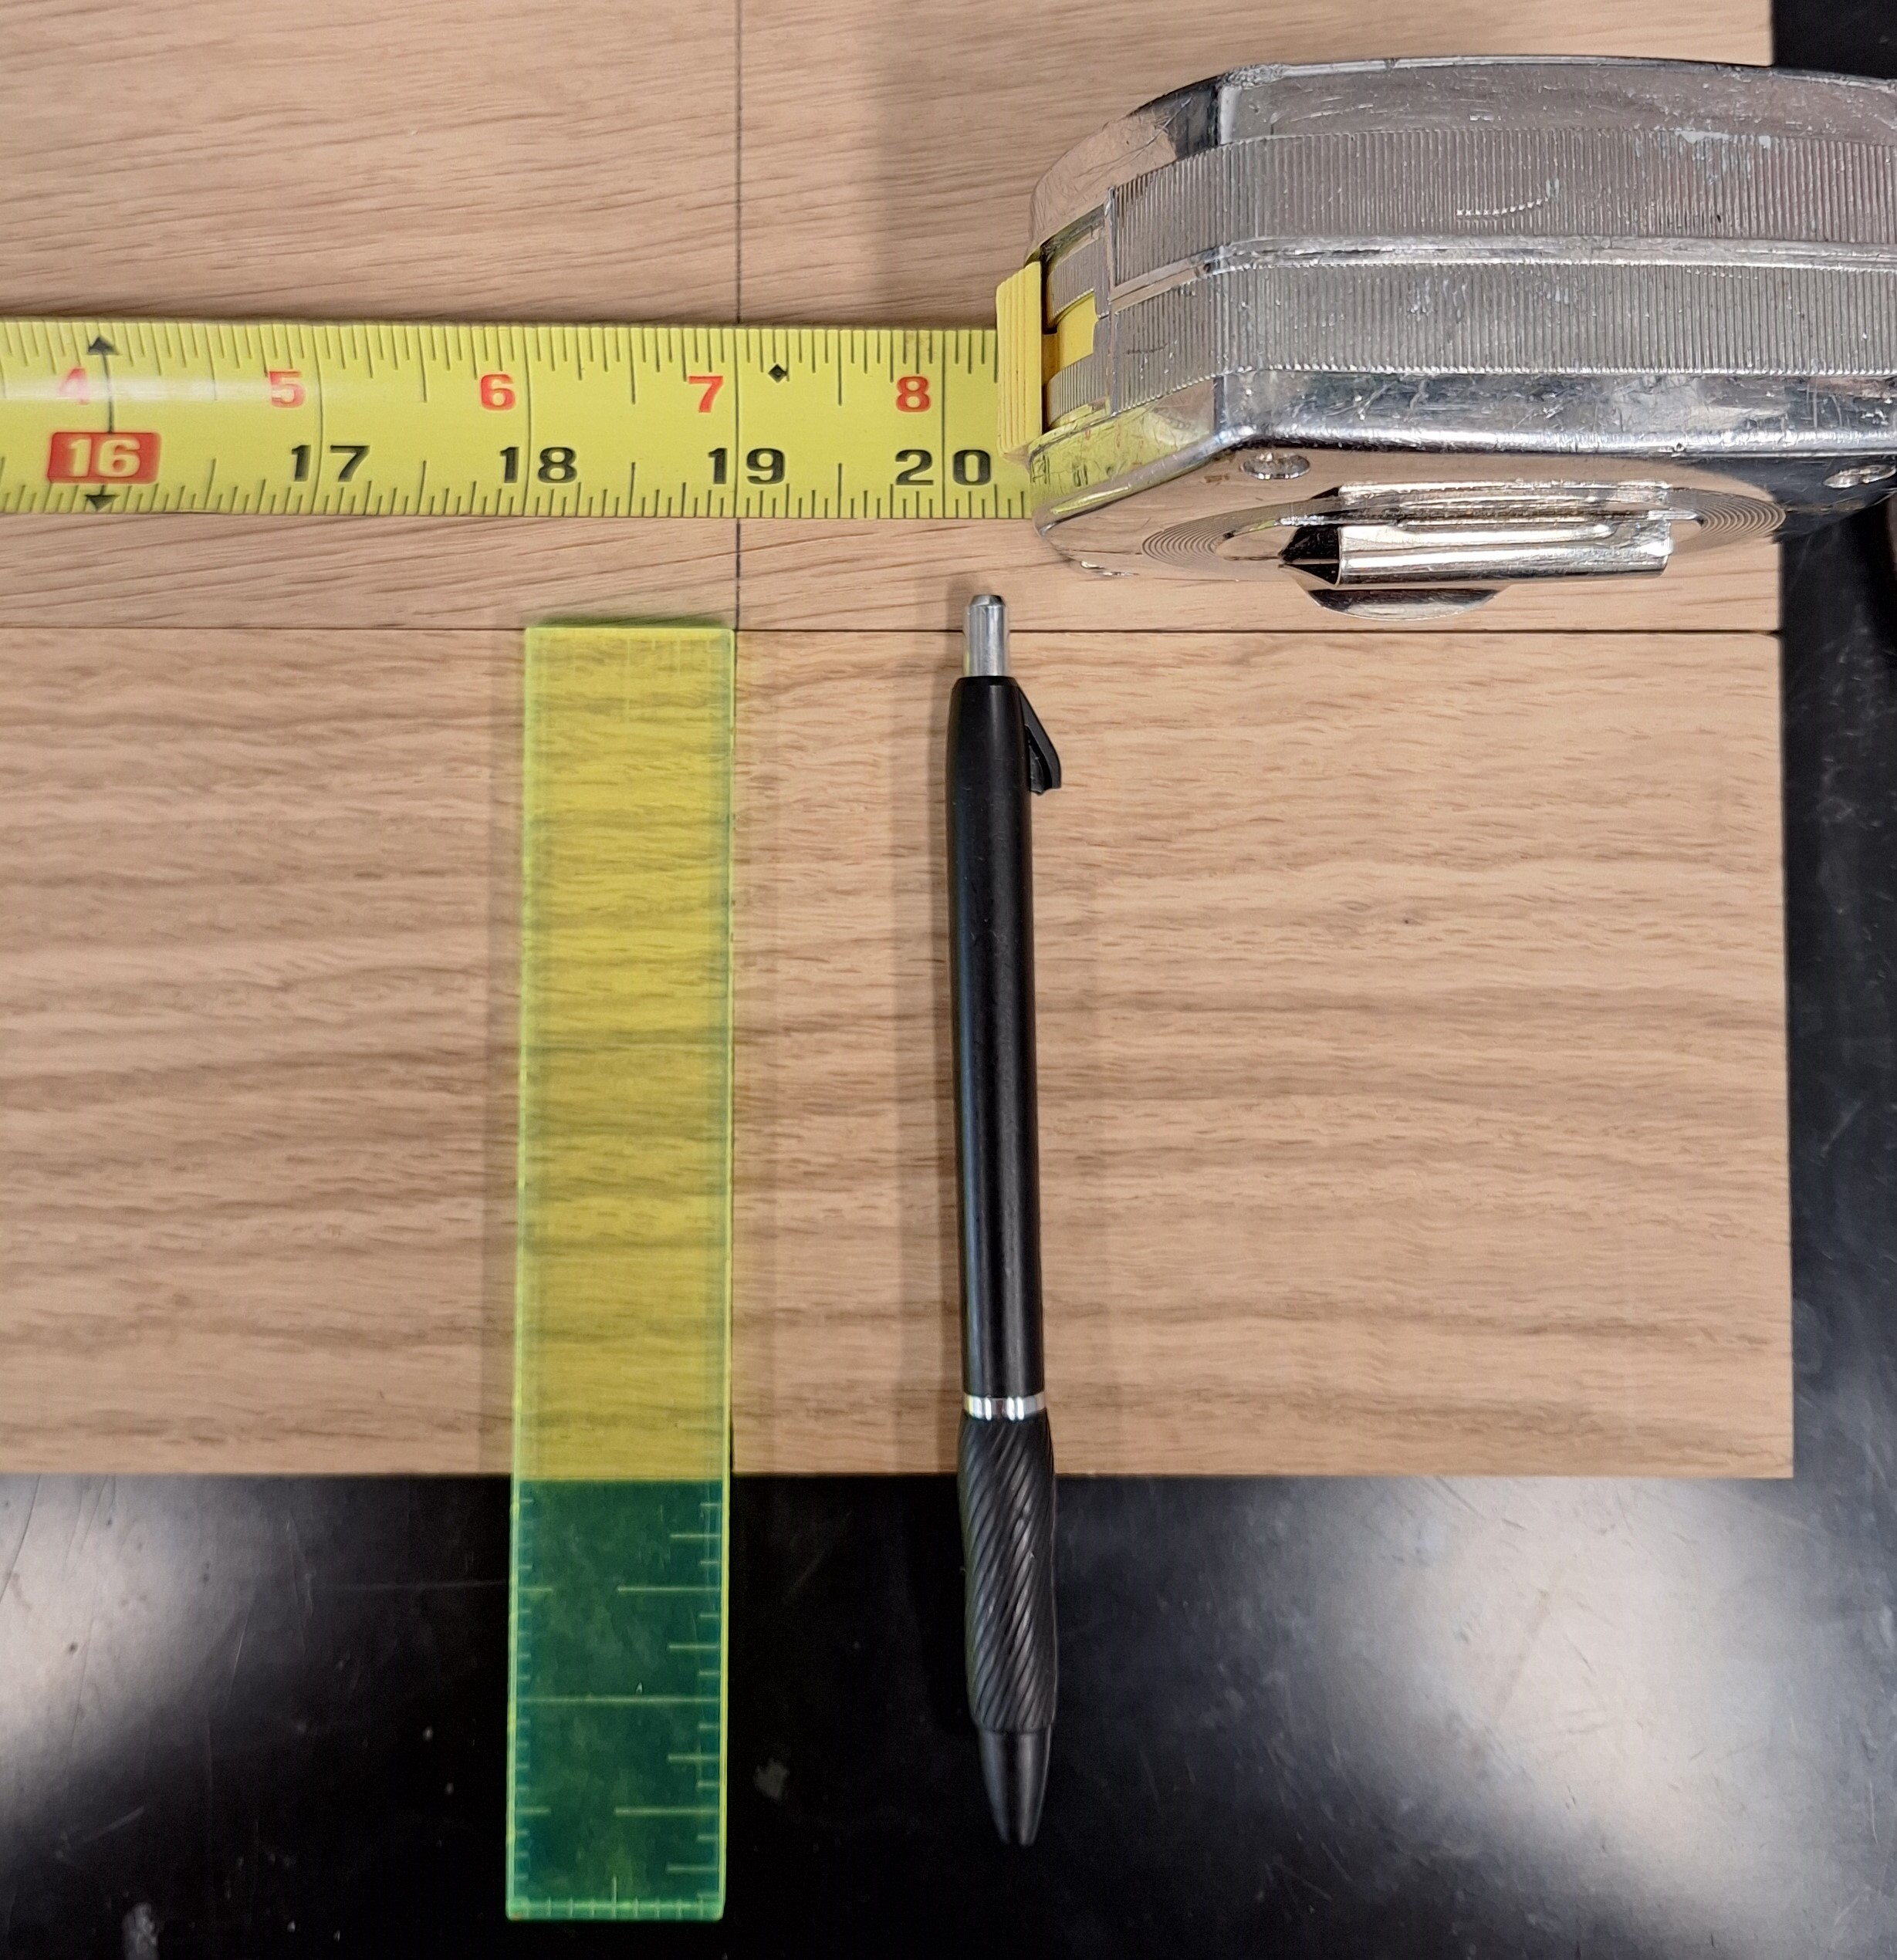
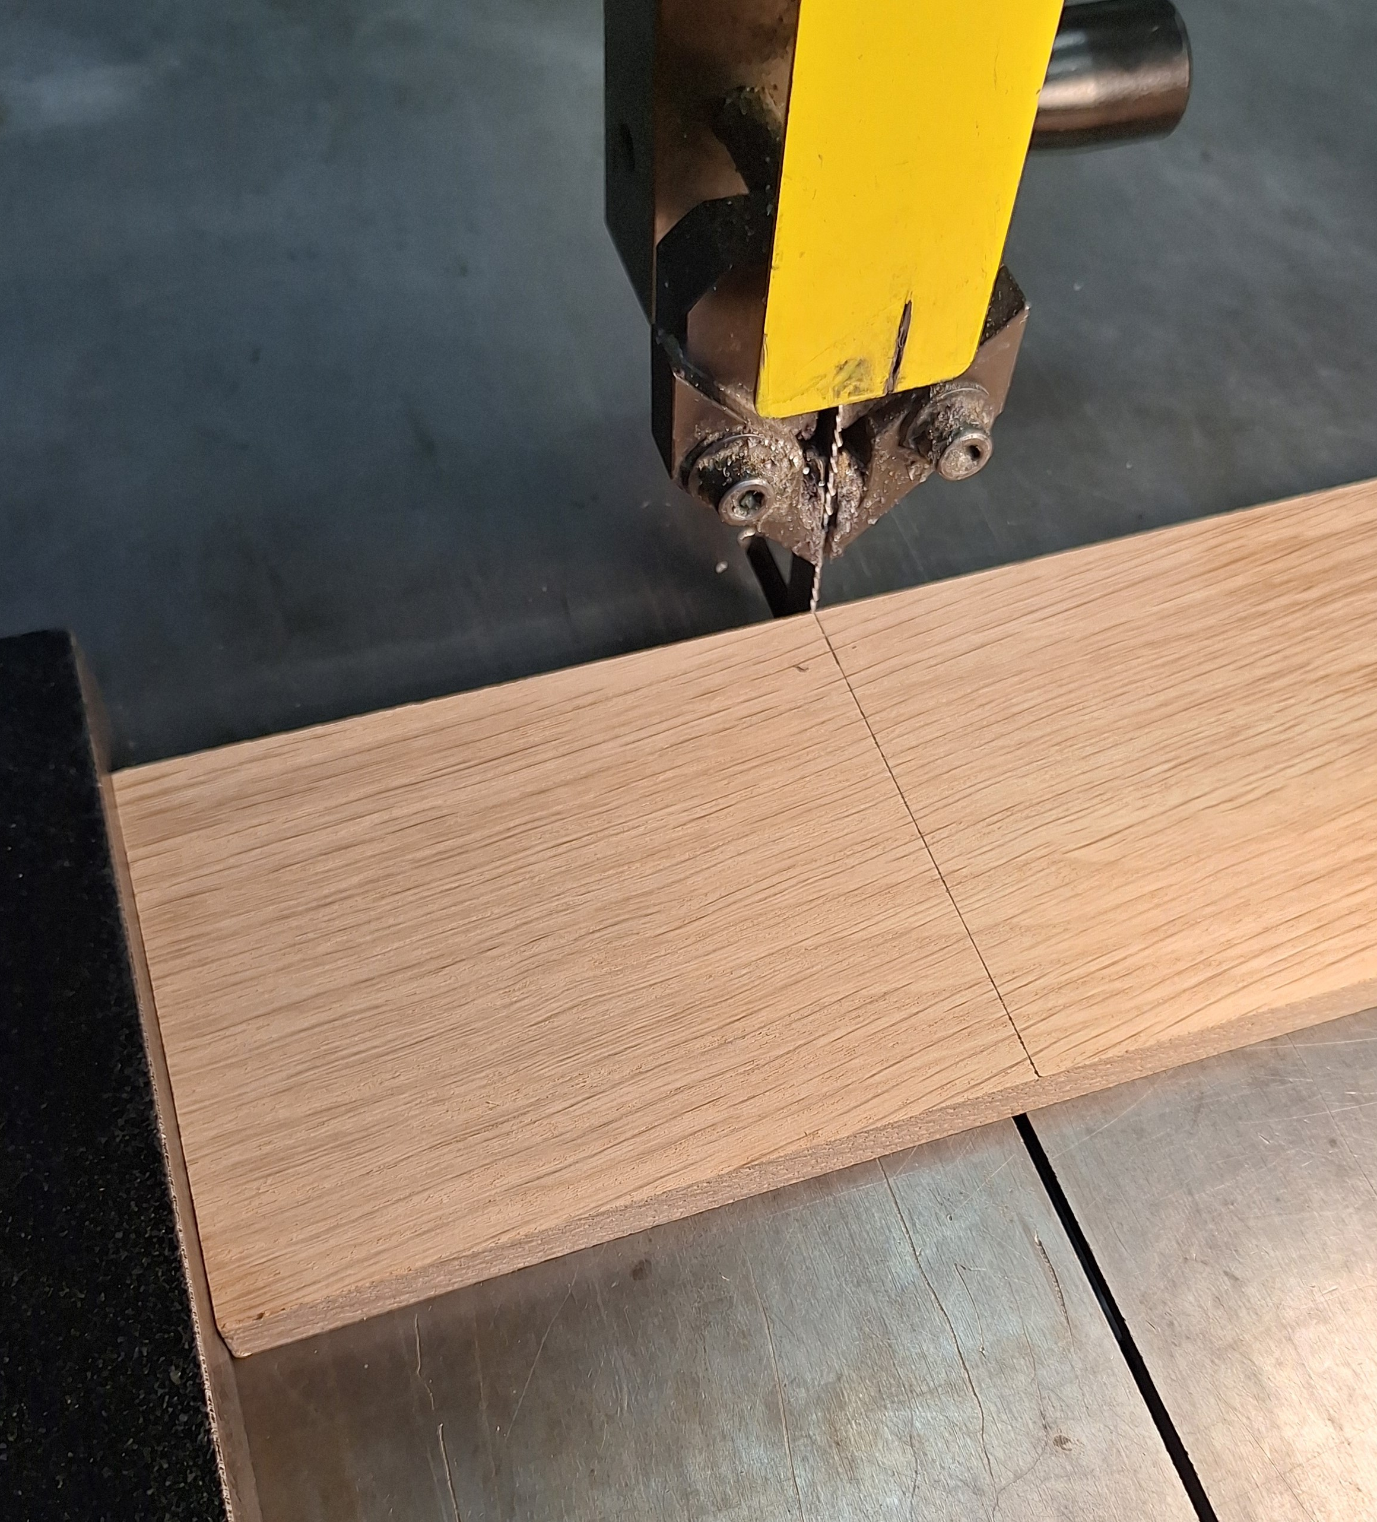
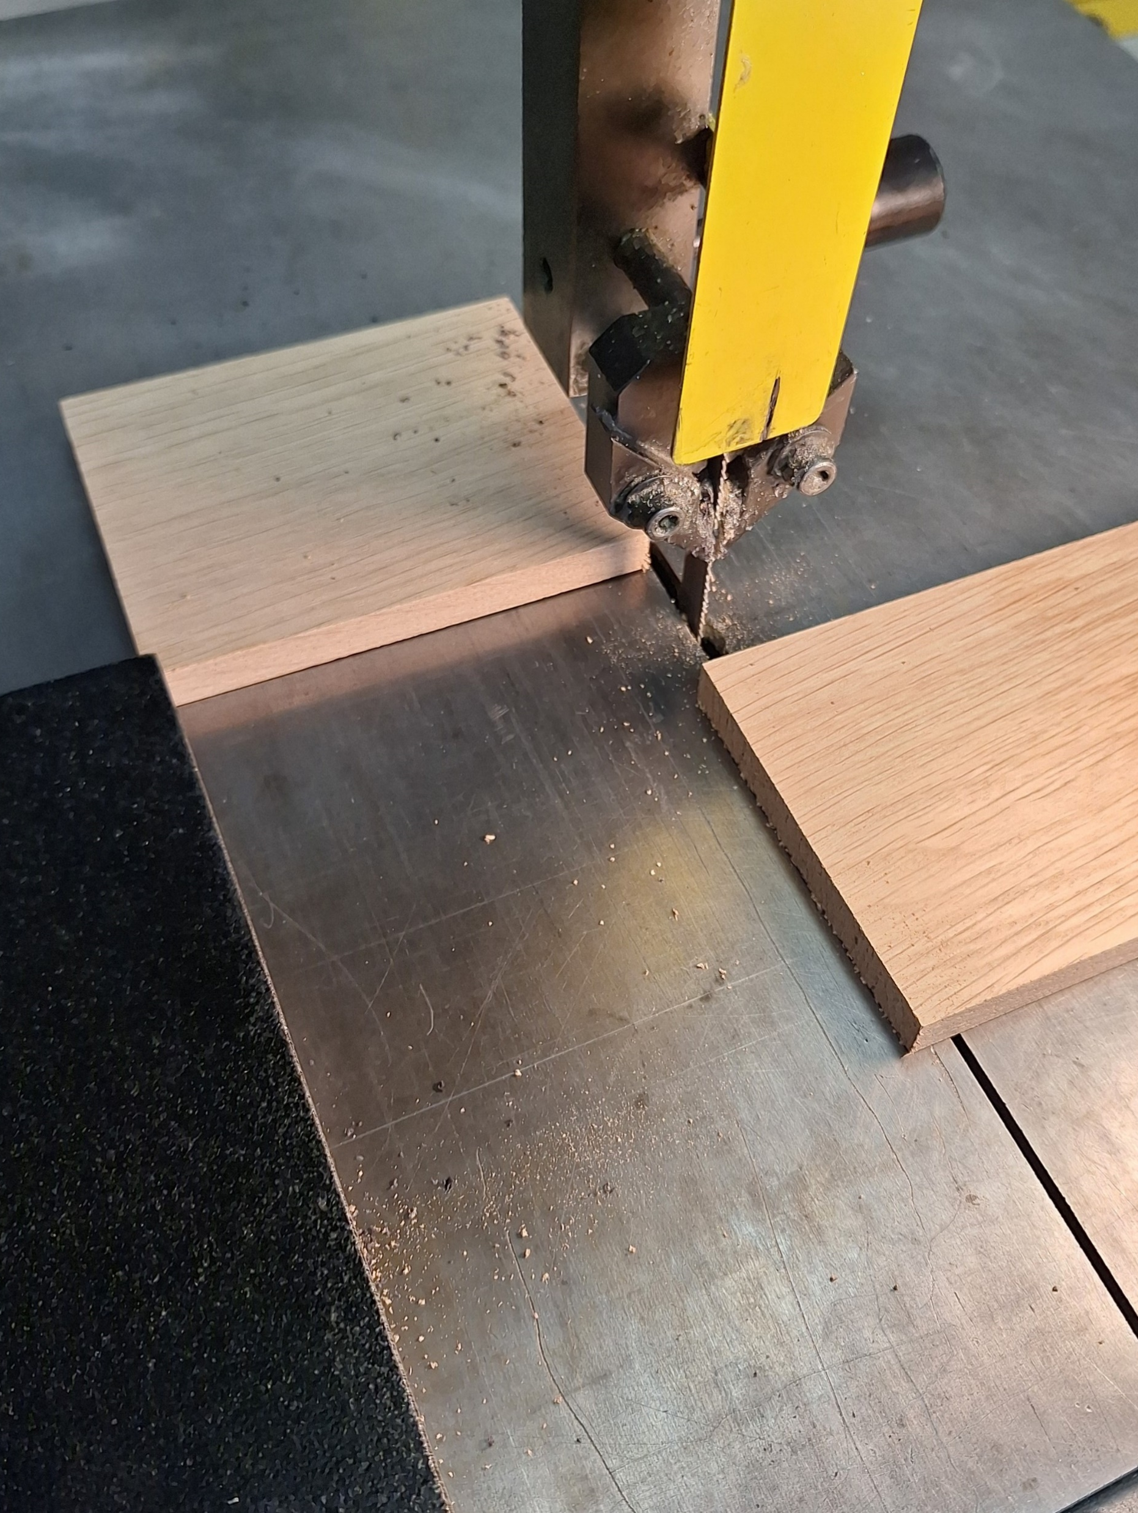
Cut board off at 19 inches

Slide 11
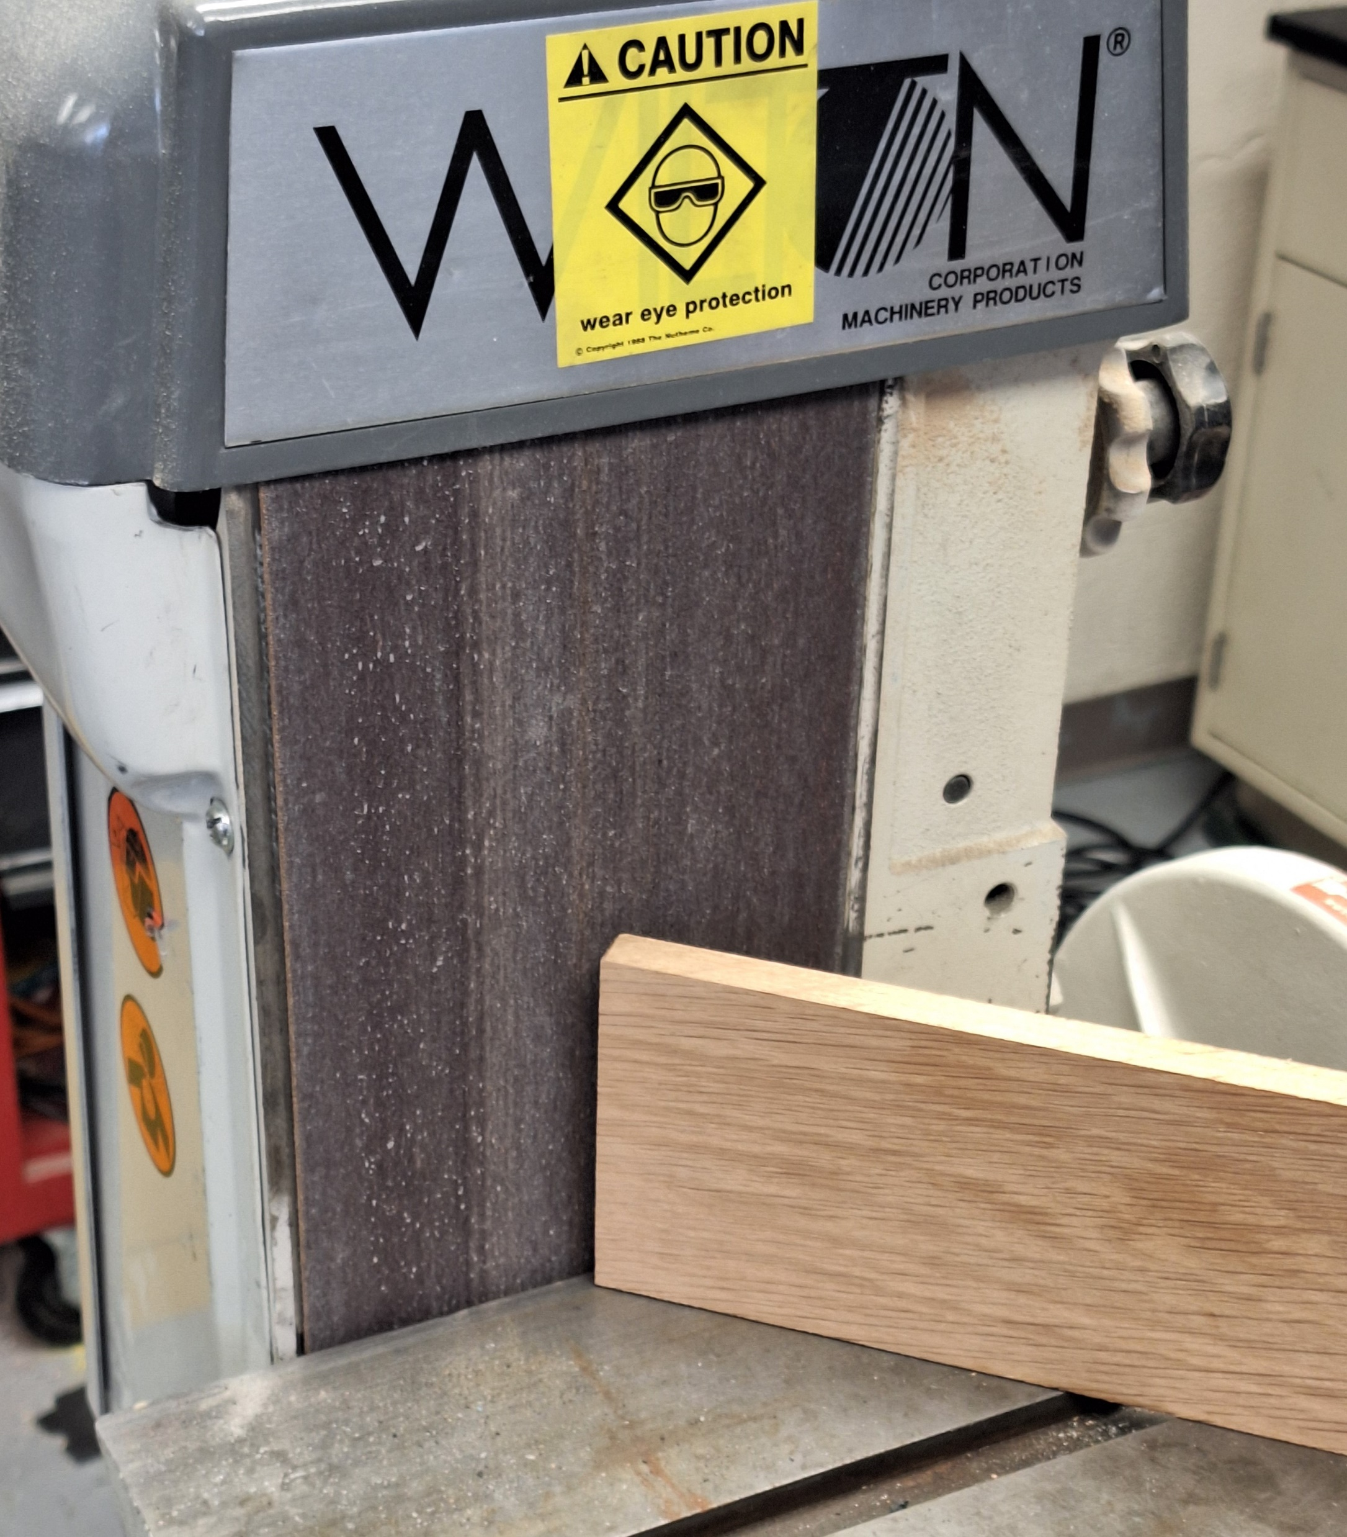
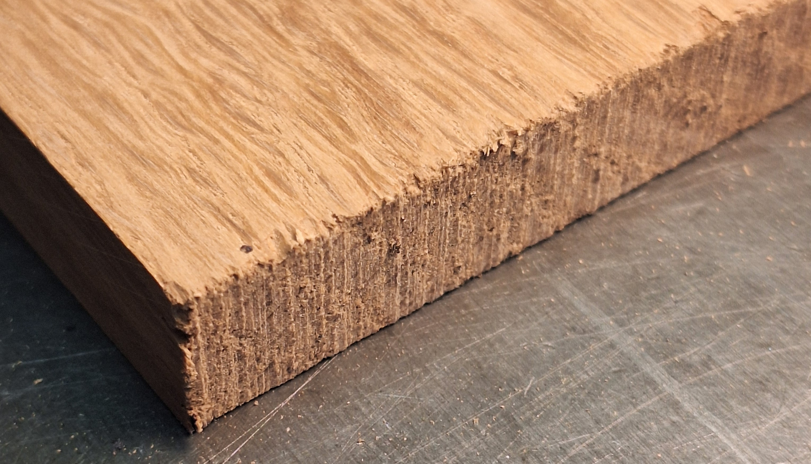
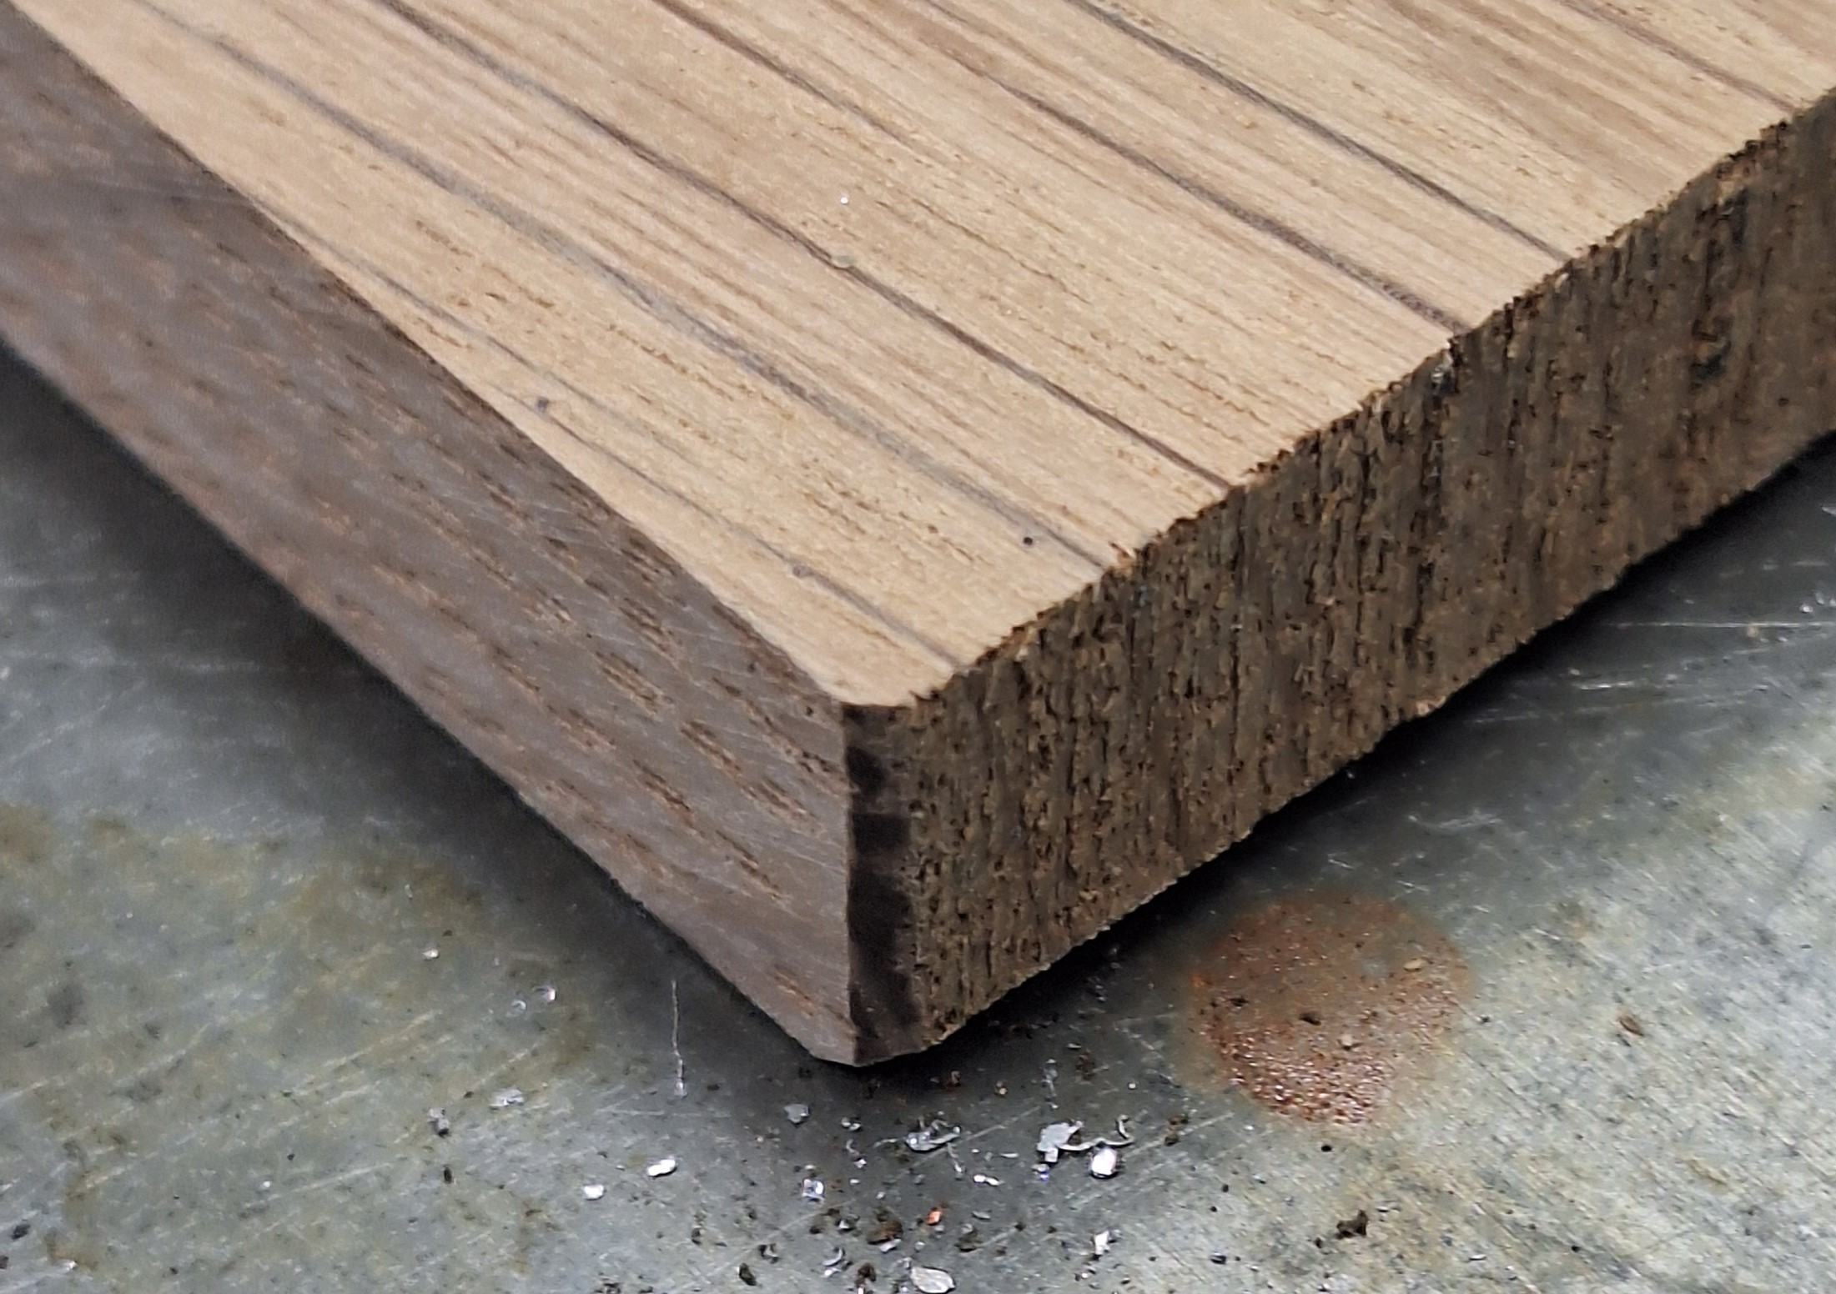
Sand or file edges

Slide 12
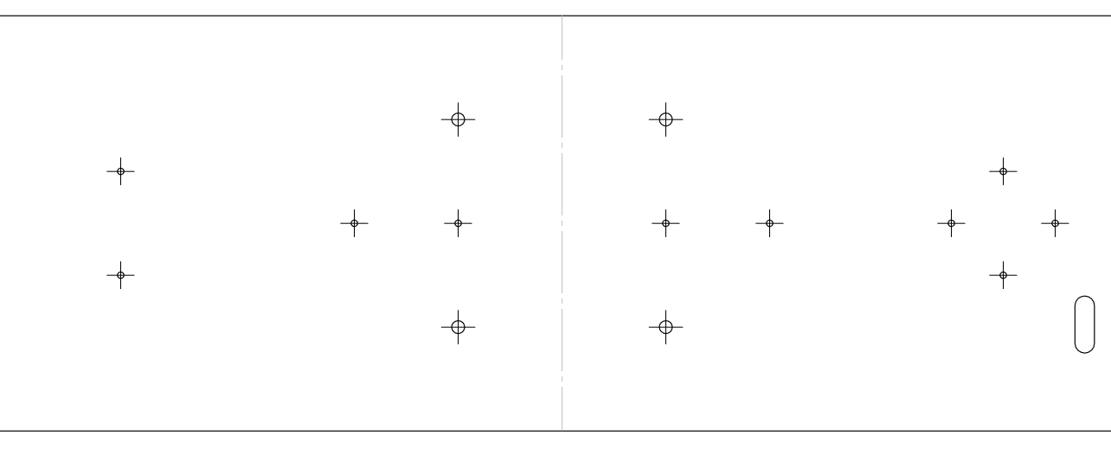
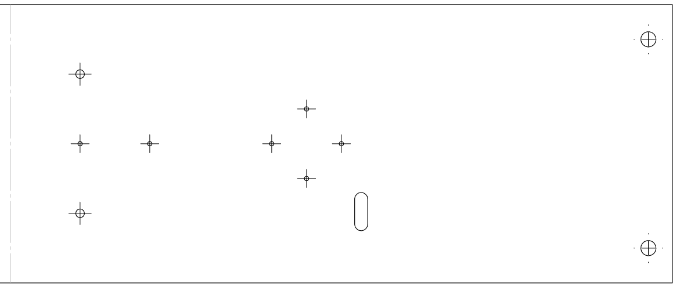
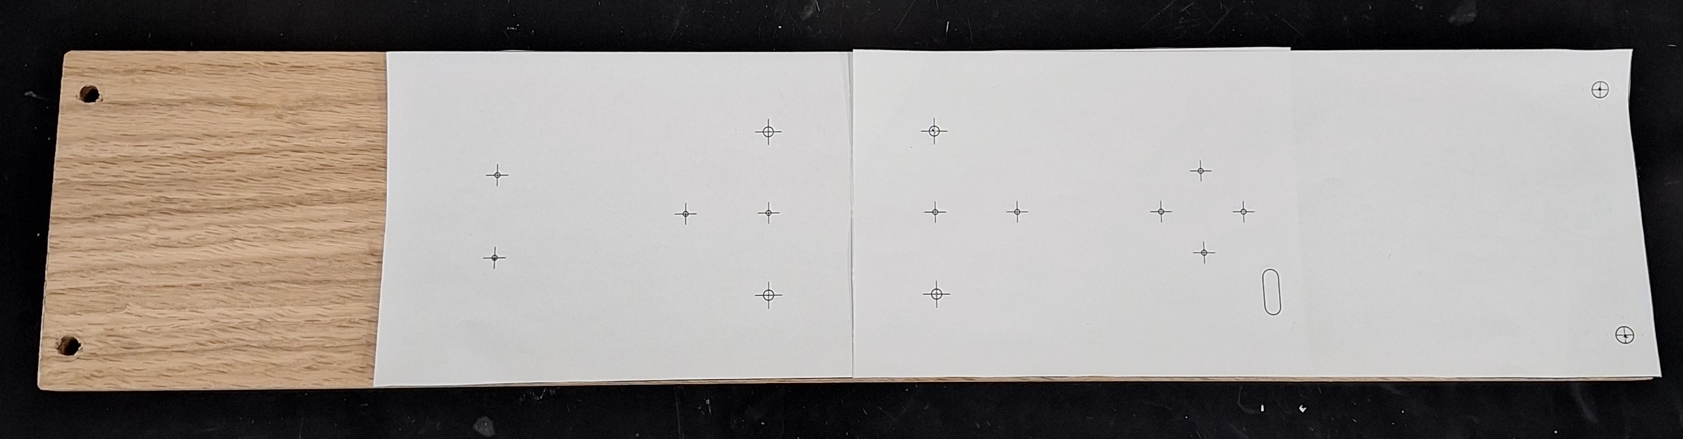
Print Templates And use for Hole Punches

Slide 13
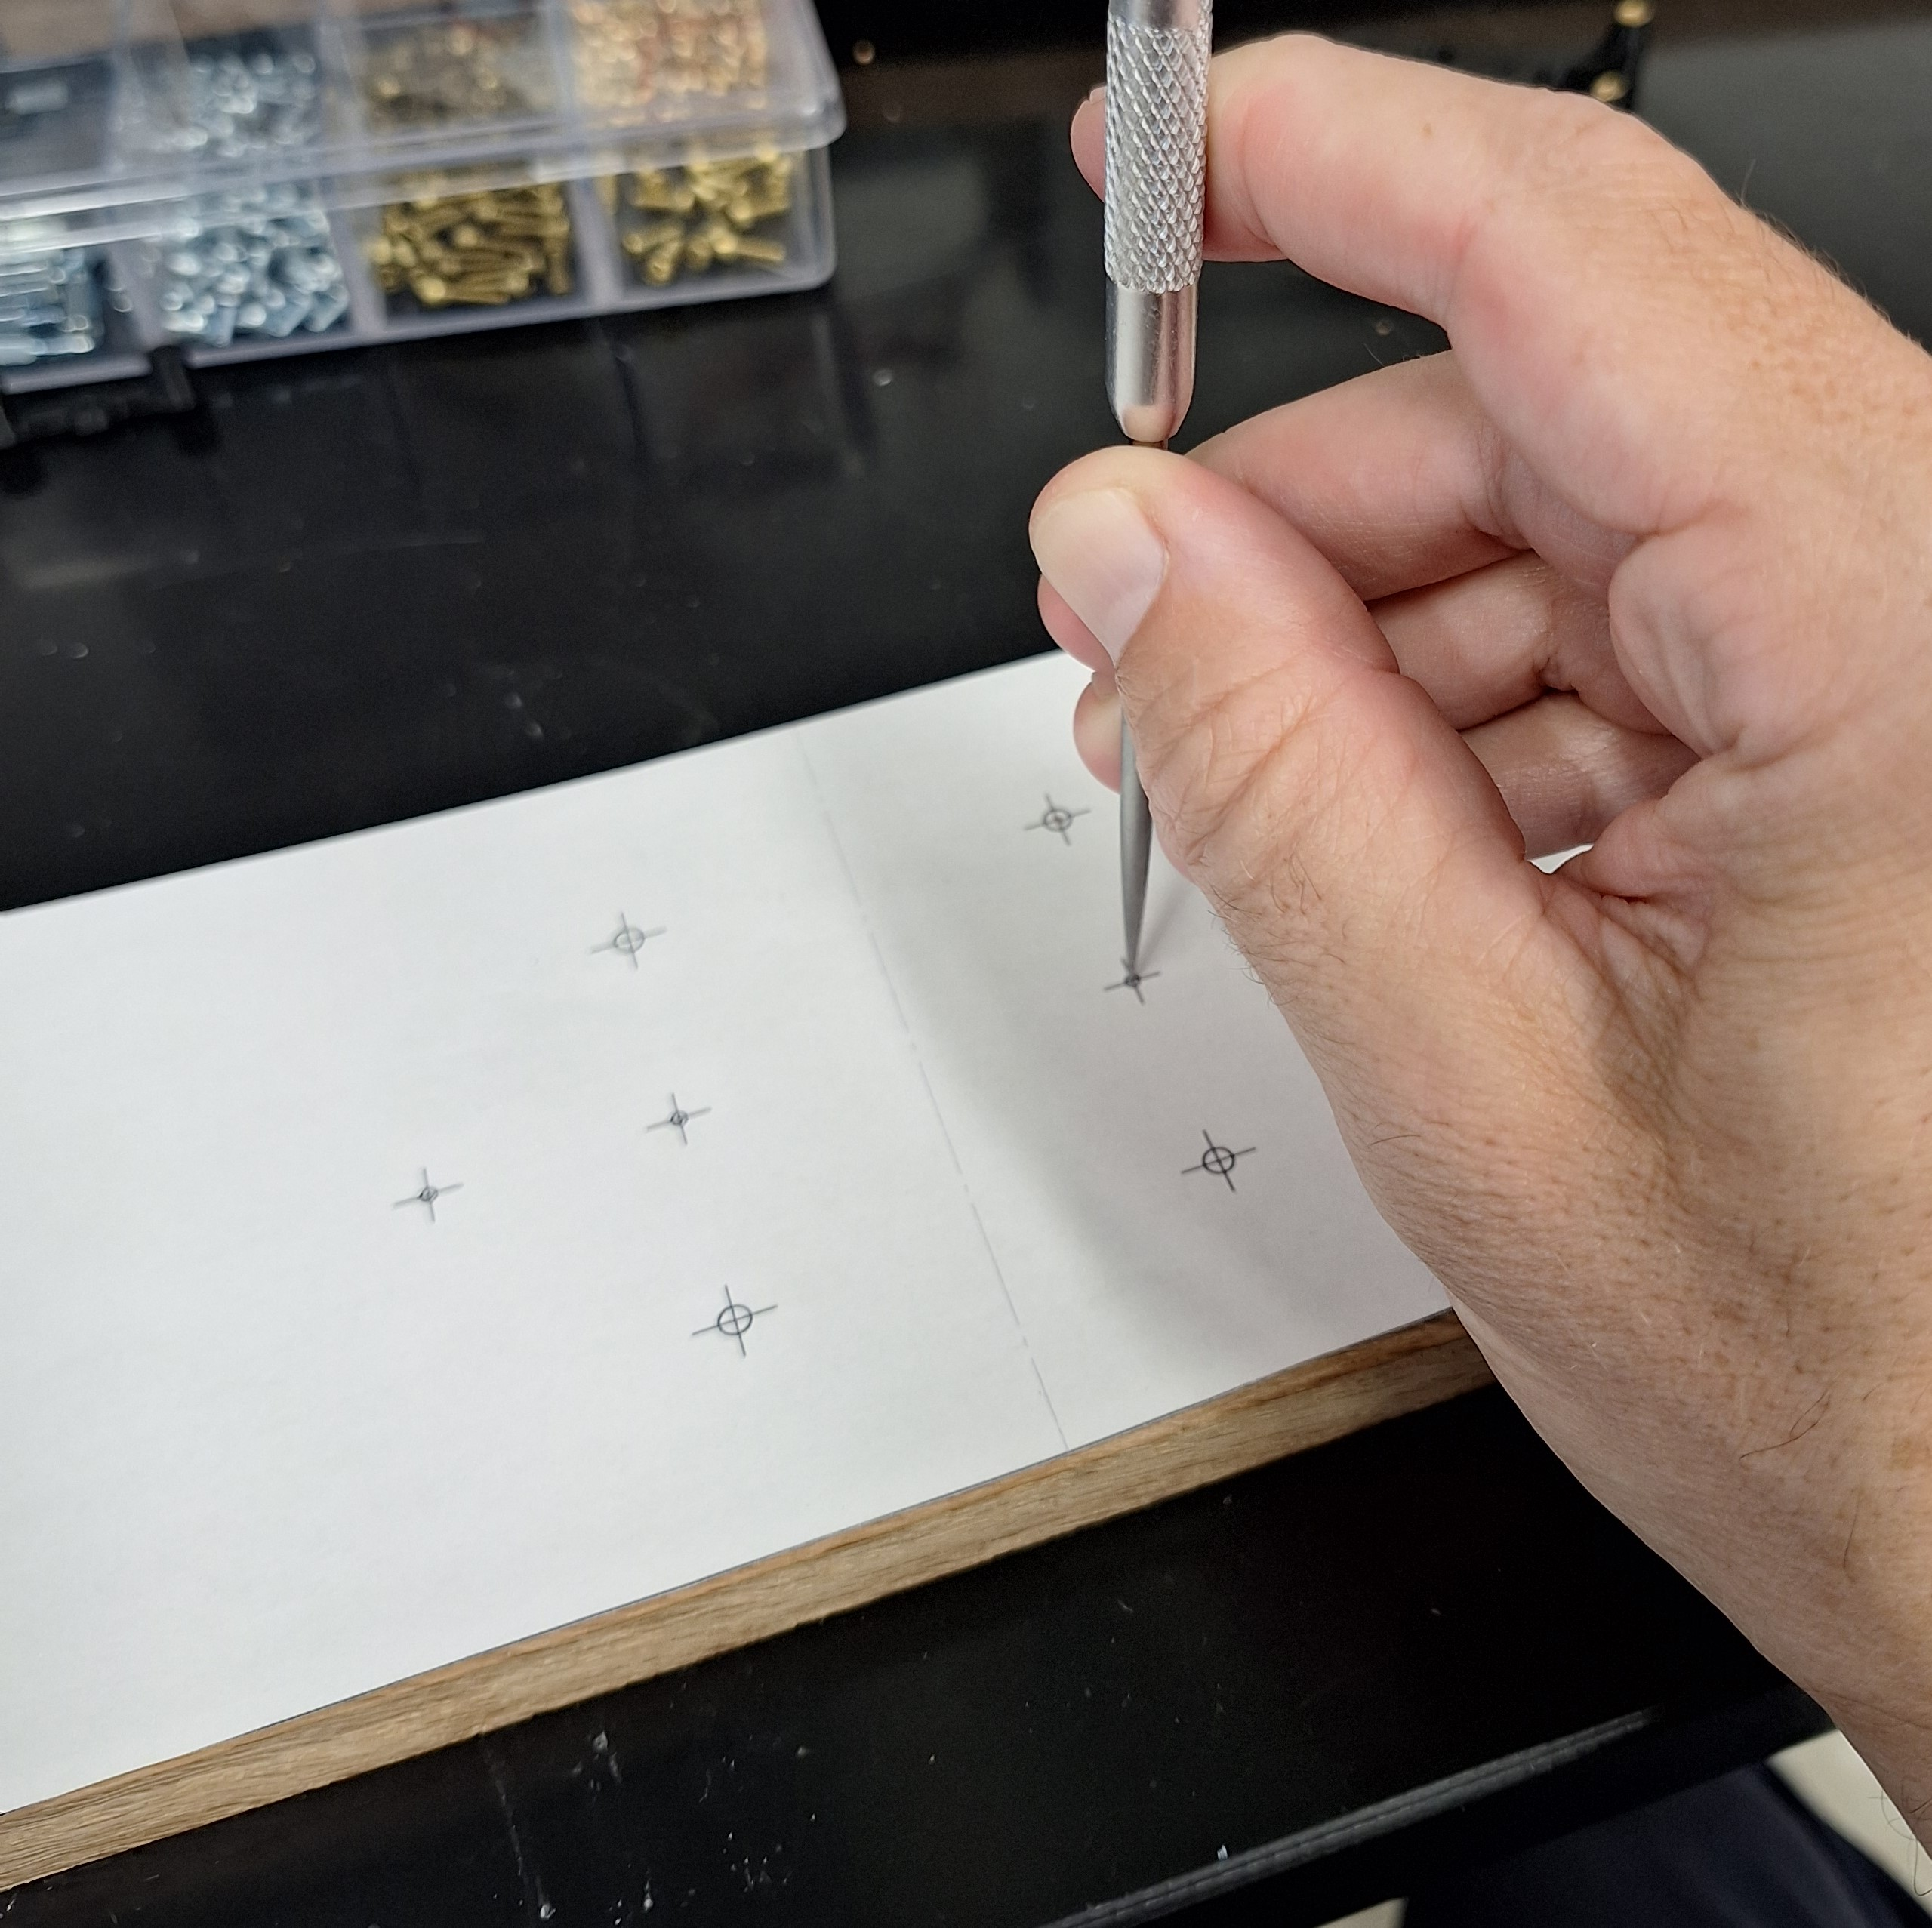
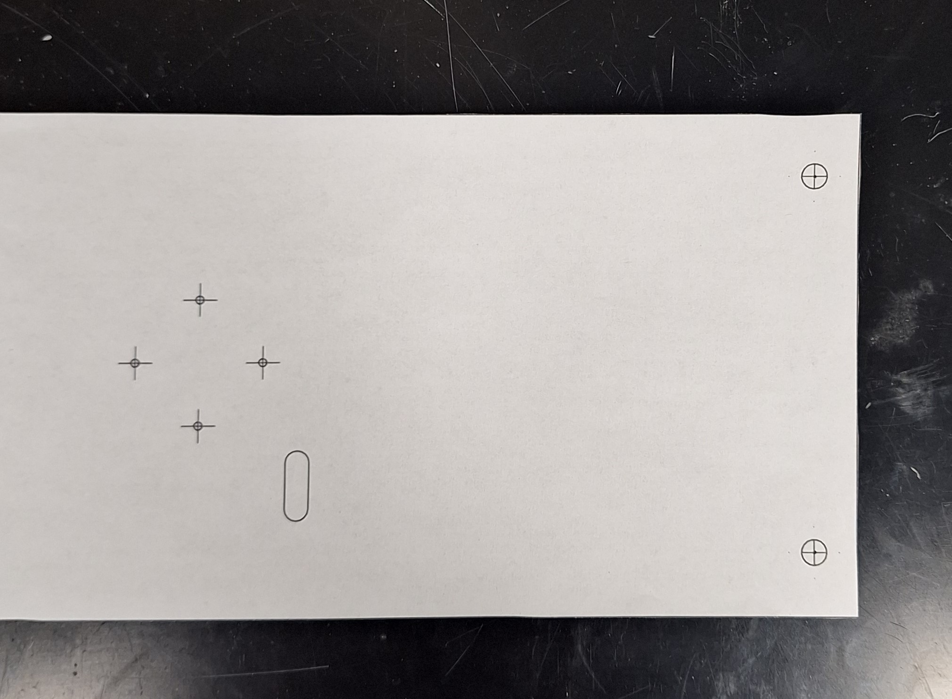
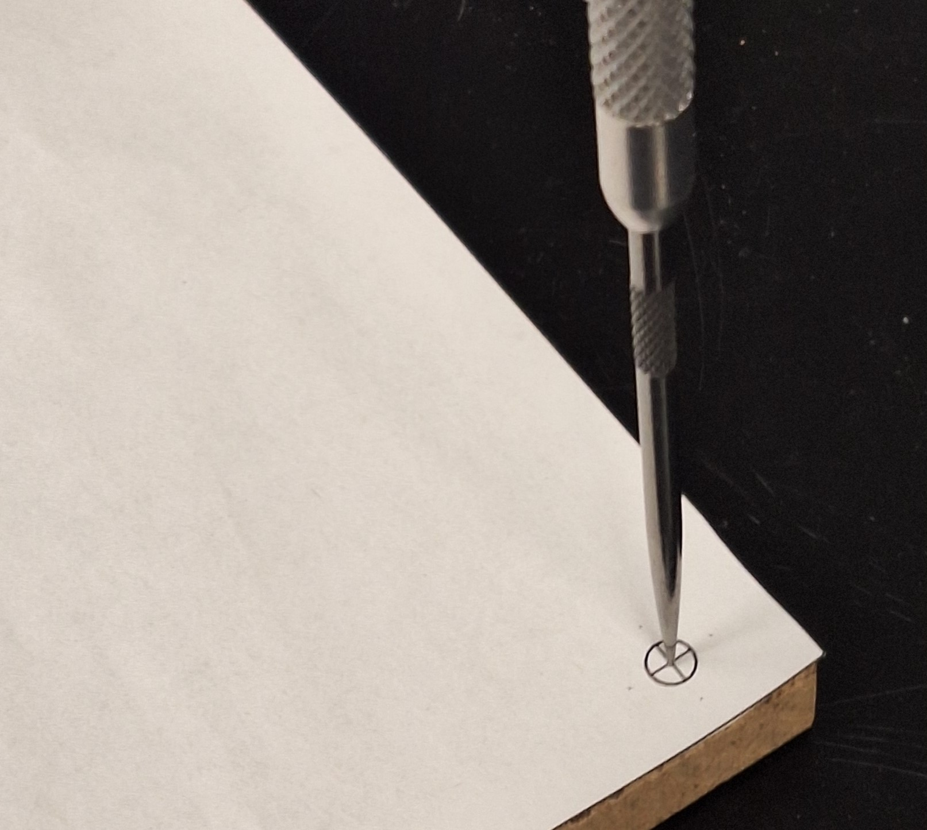
Punch hole locations with sharp object

Slide 14
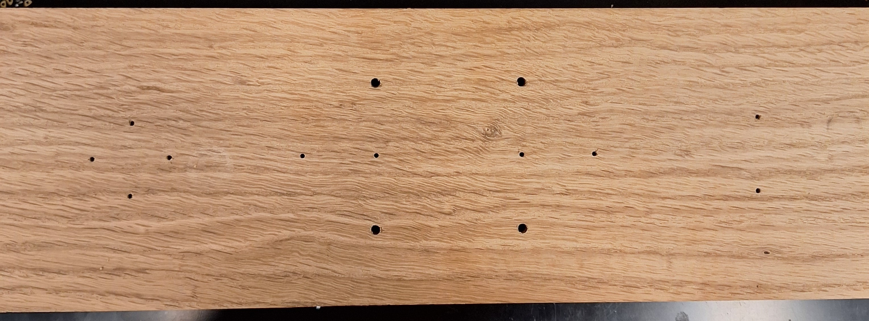
Drill pattern in center of board
1/8”
1/16”
1/16”

Slide 15
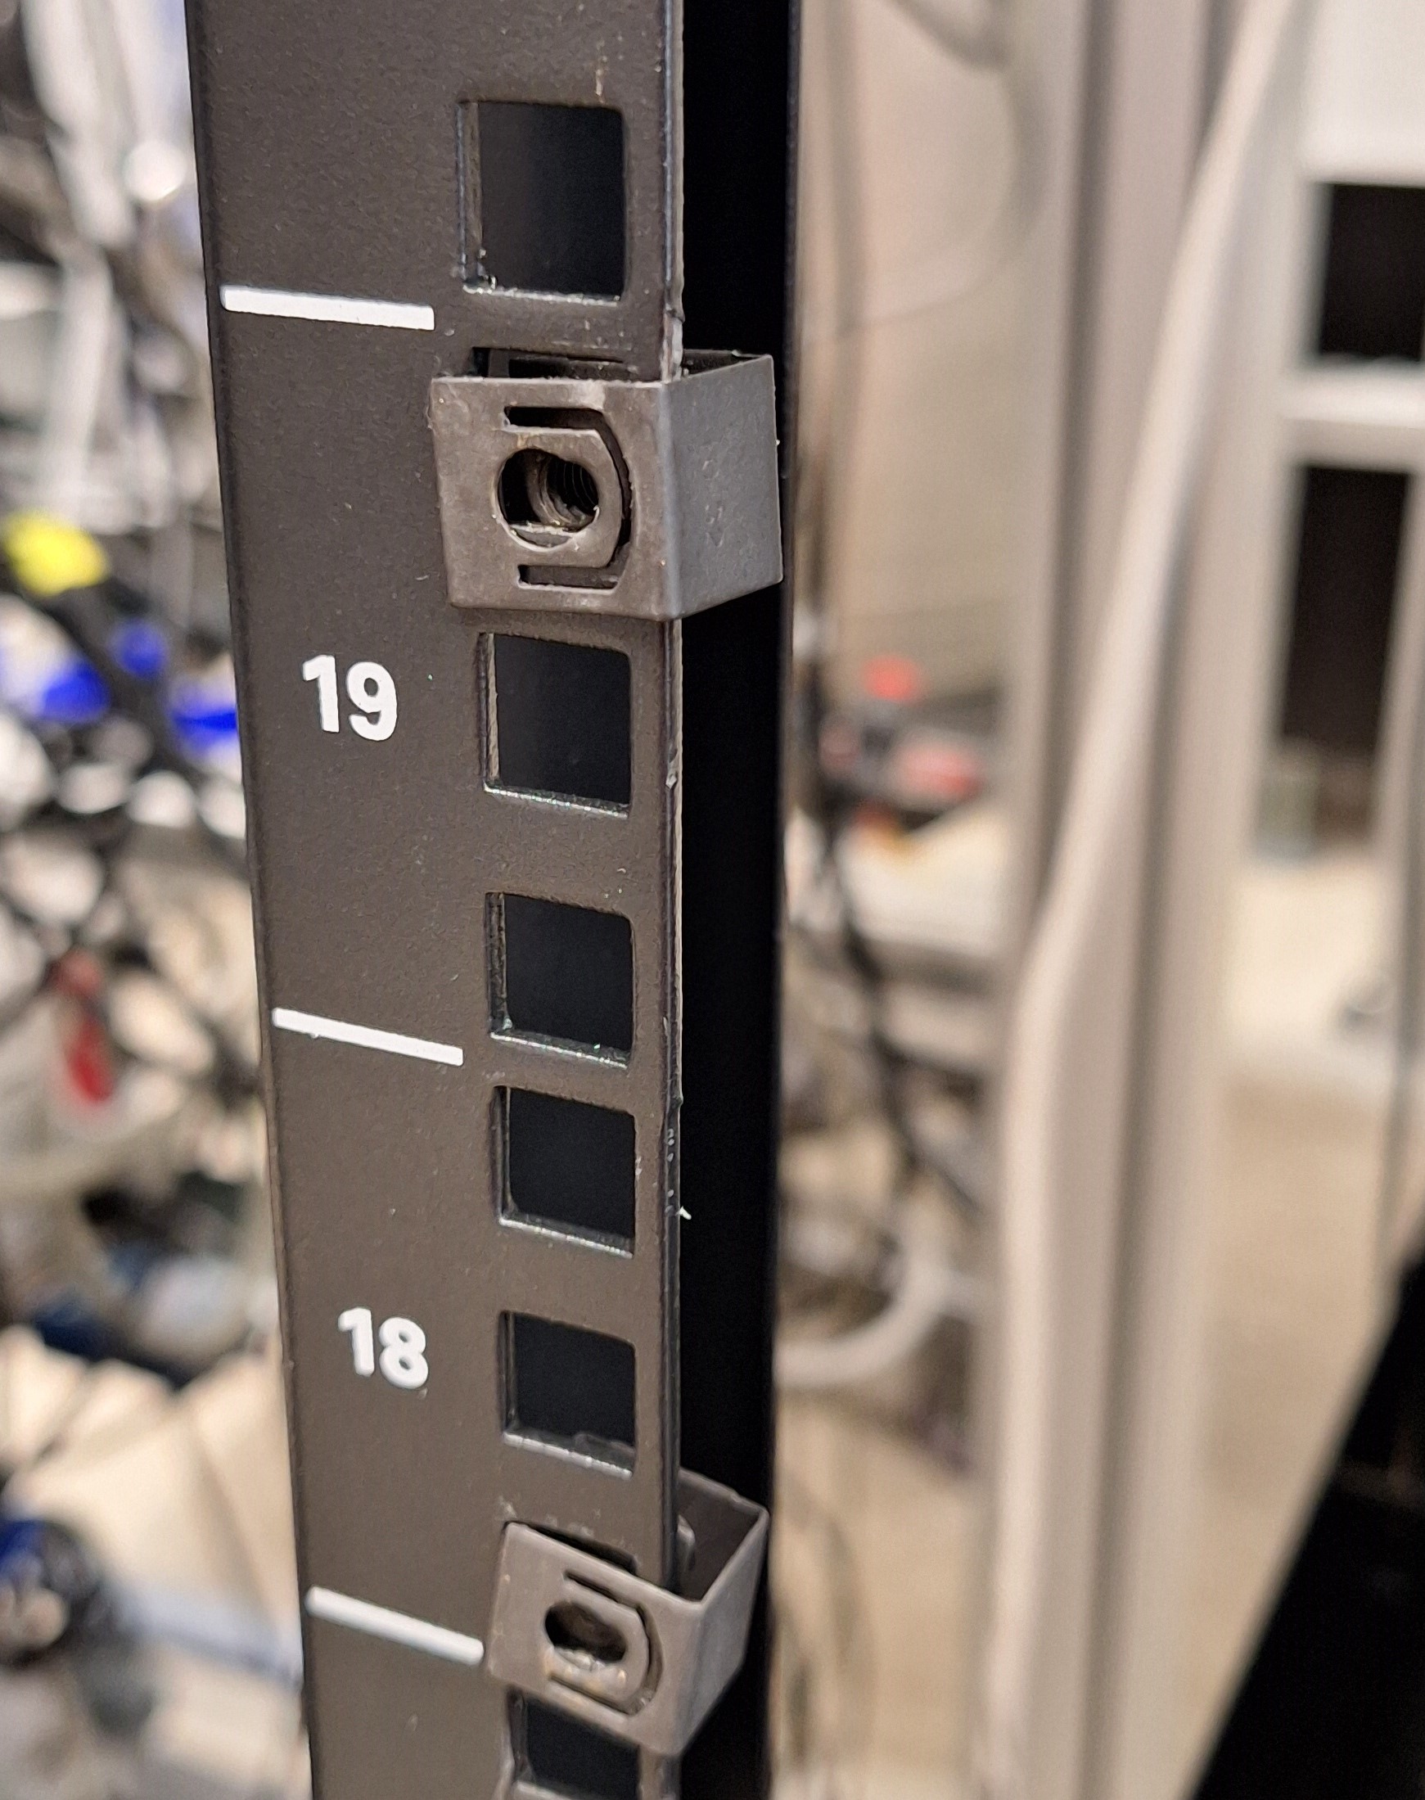
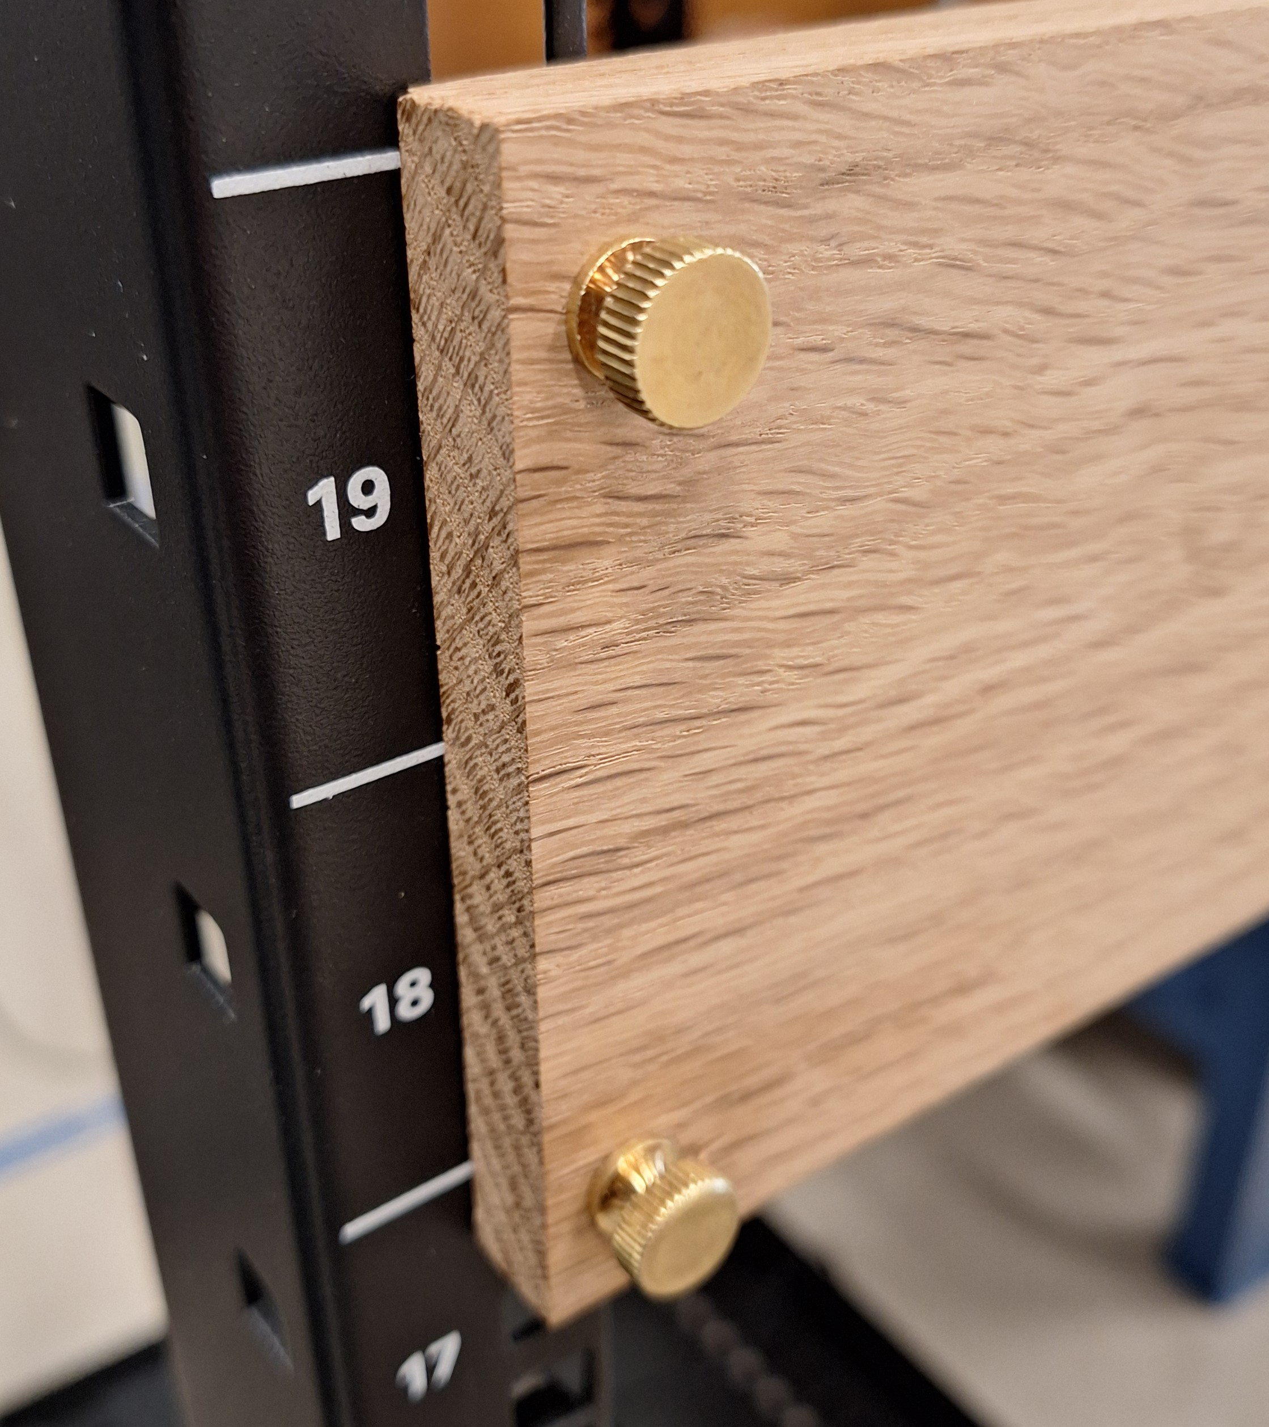
Rack, nut and thumb screw detail

Slide 16
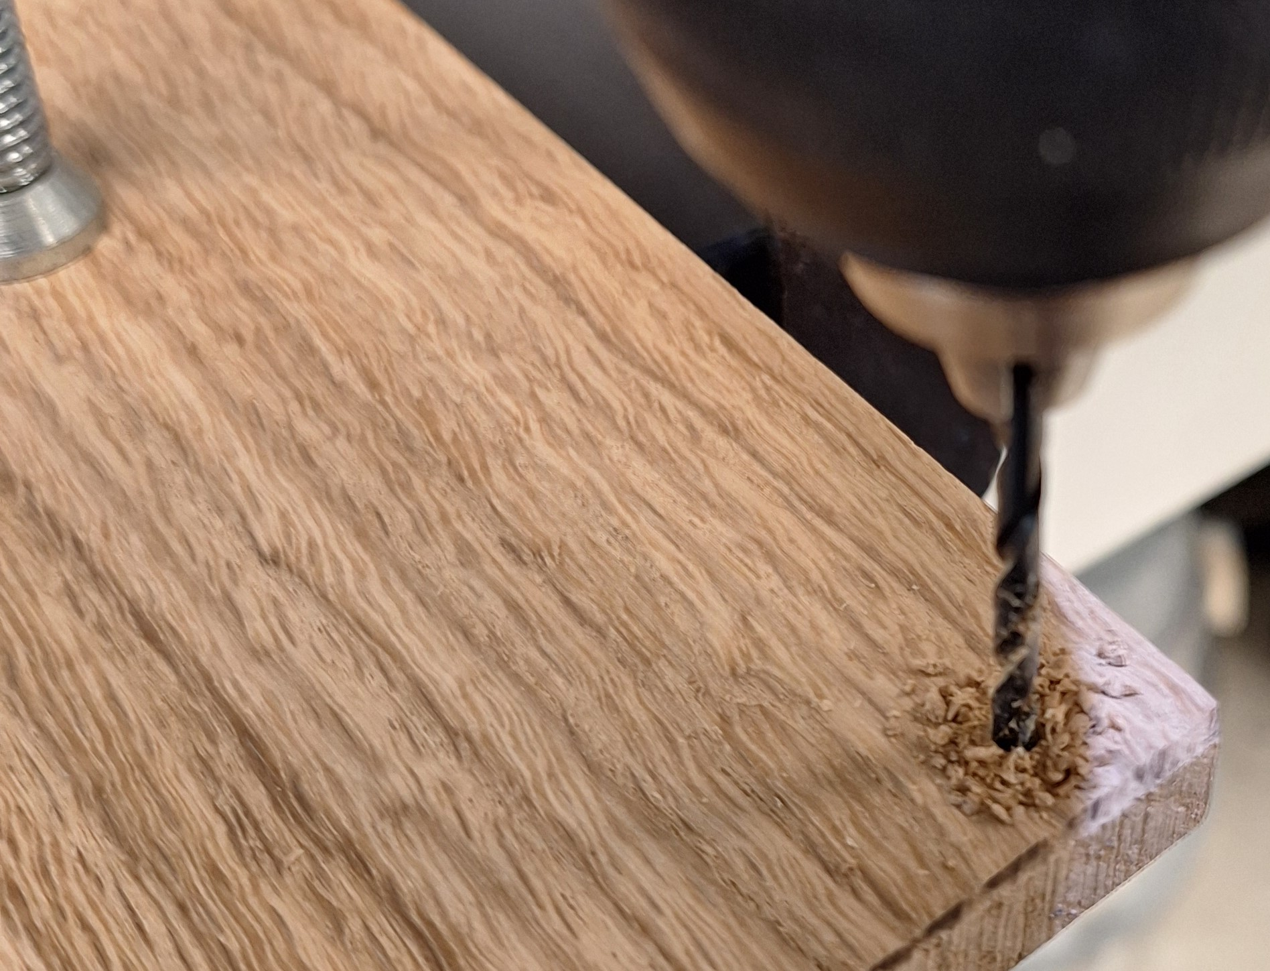
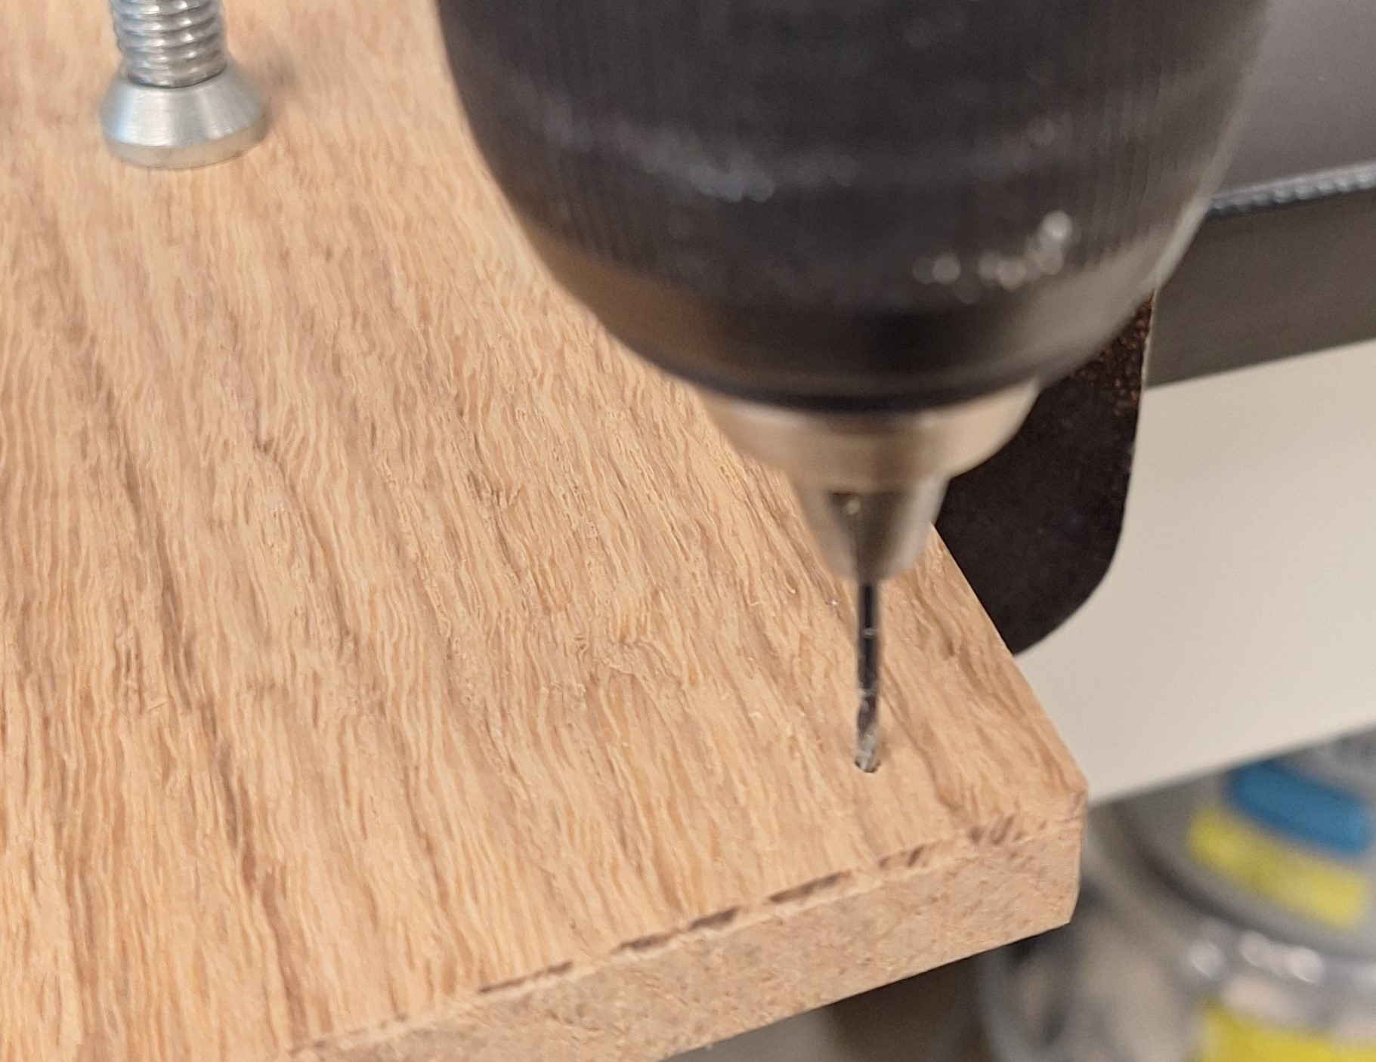
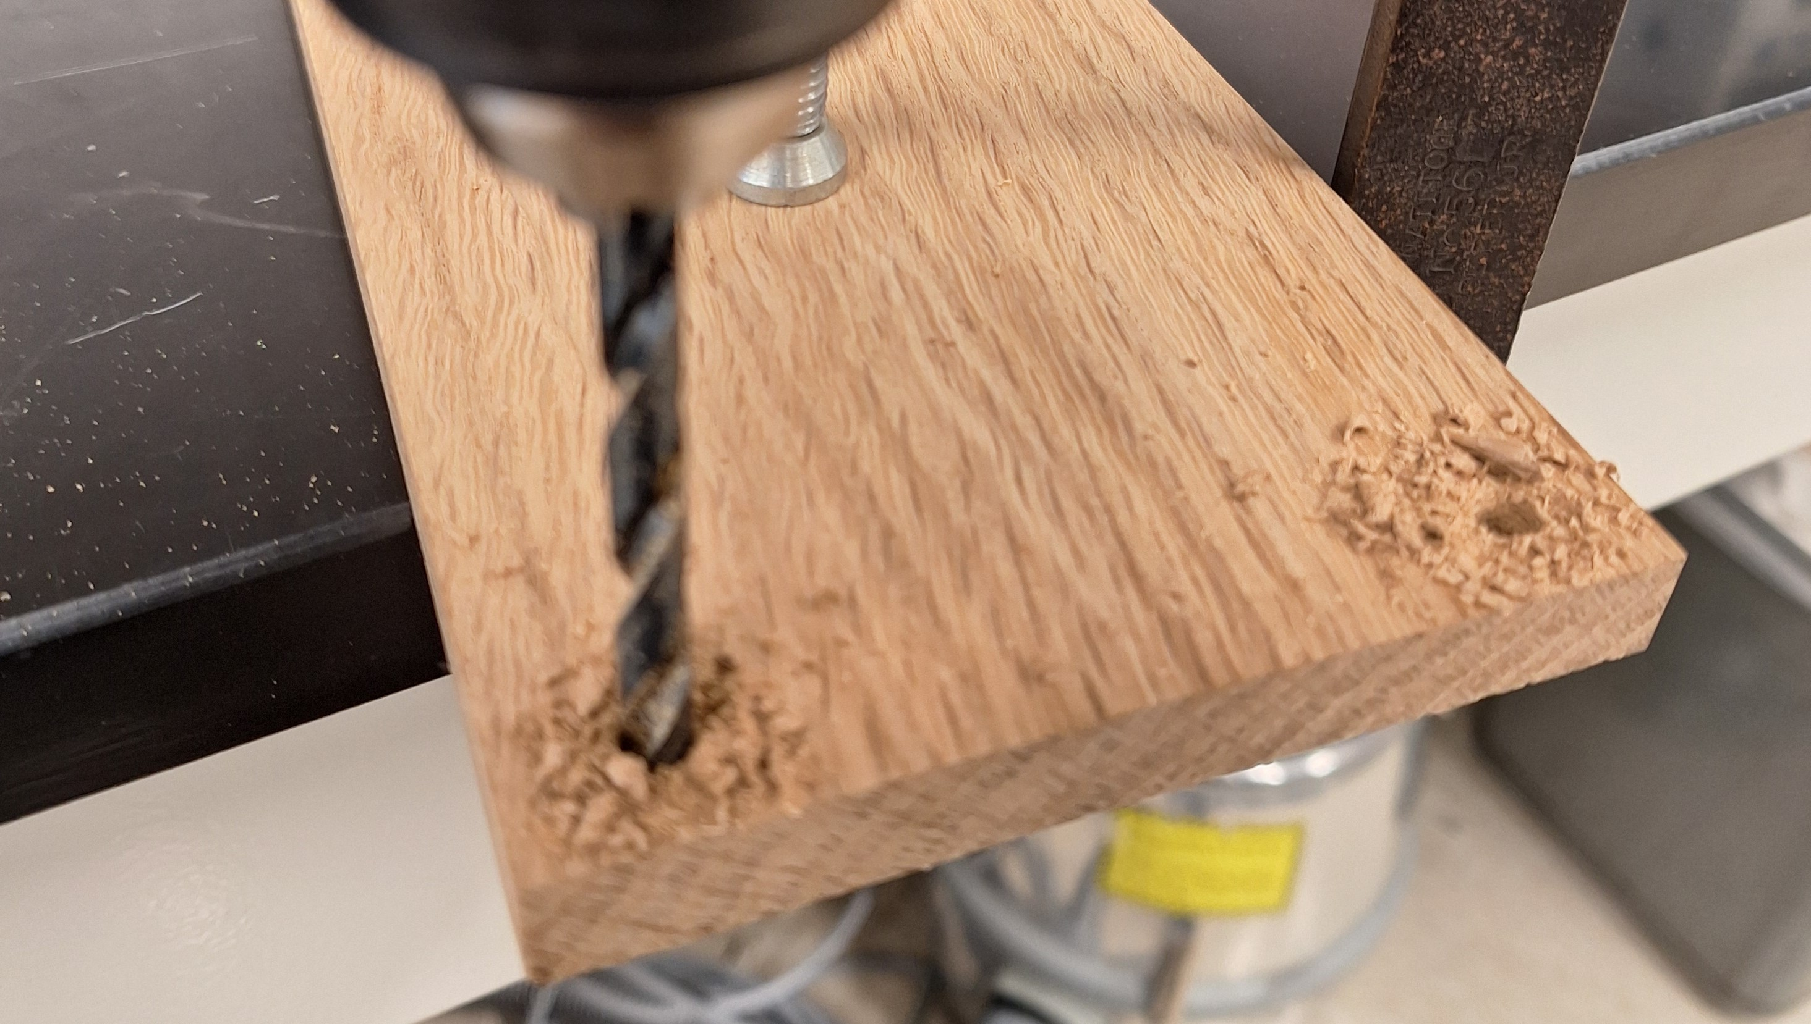

Slide 17
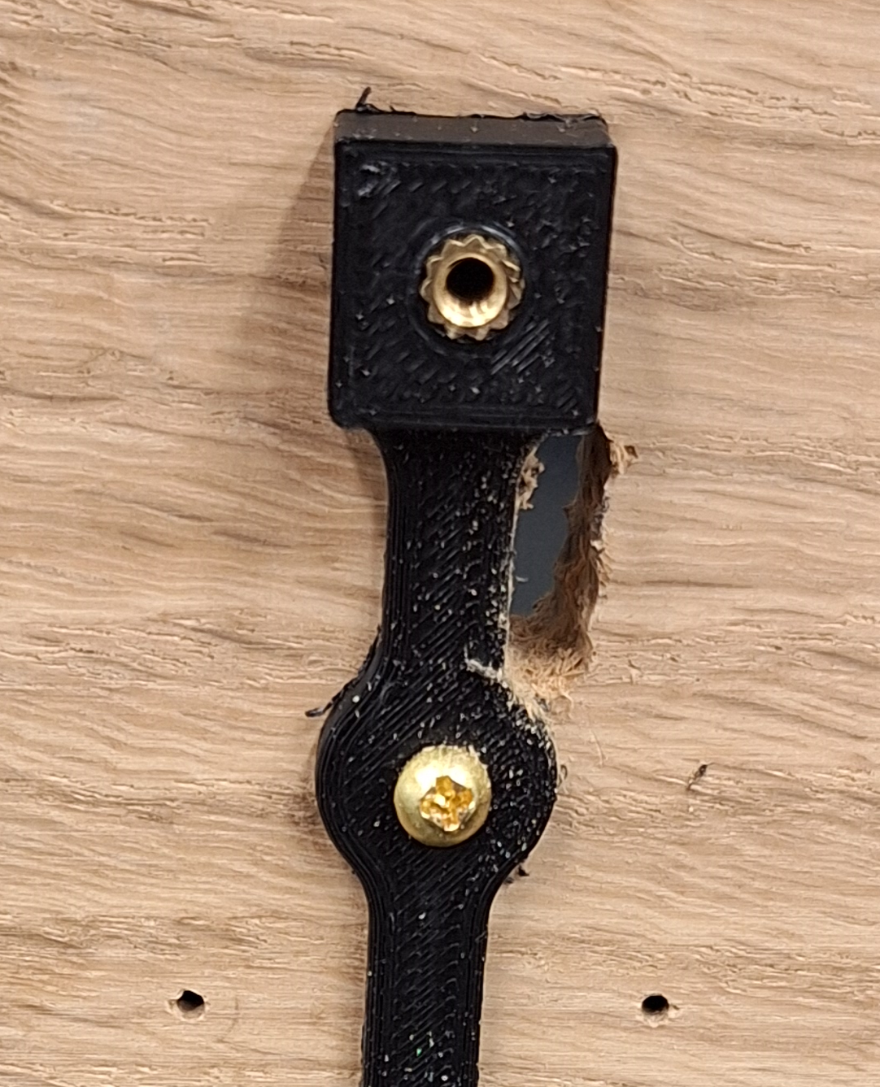
Hand-drilled cutout for 4 pin connector

Slide 18
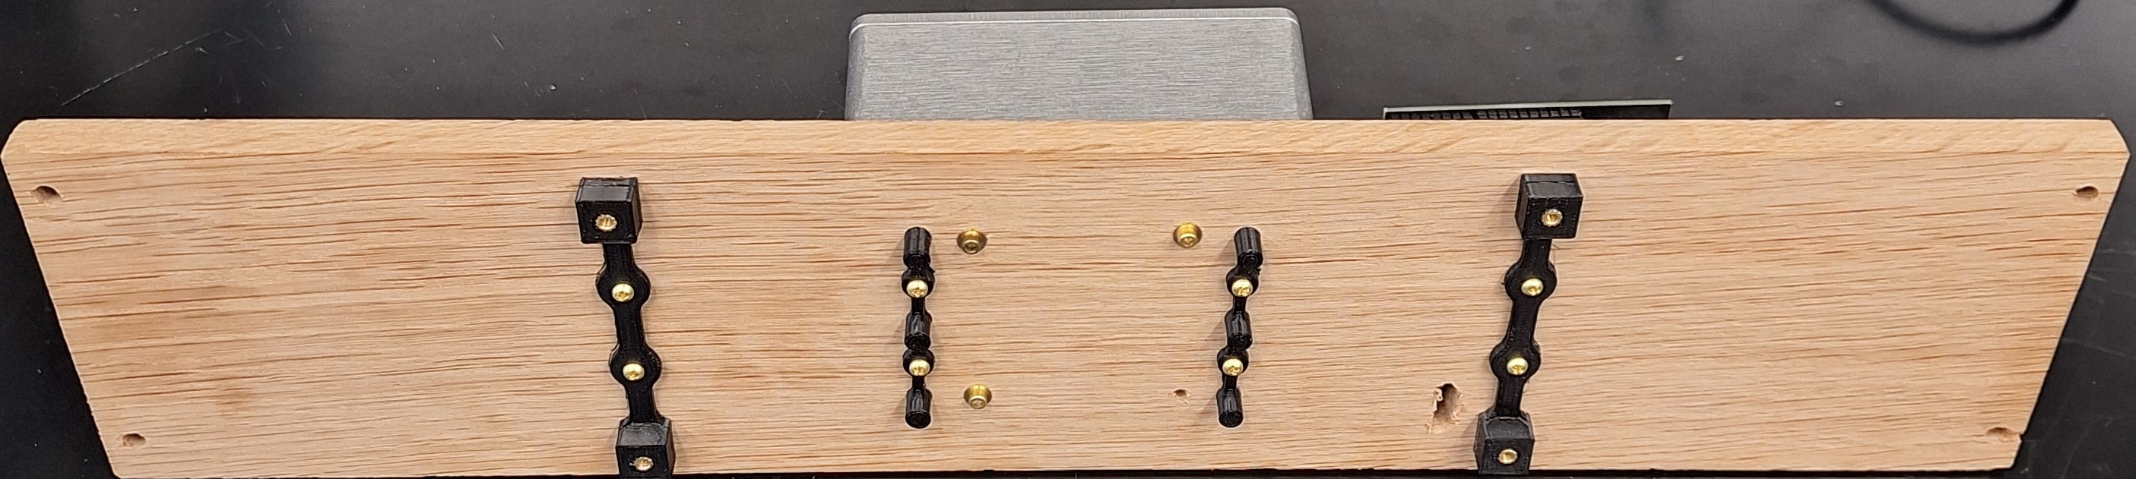
Full assembly with Bud Box and 3d printed parts

